Slide 1
Linking Student Equity with Accreditation
FHDA District Opening Day / September 22, 2016
Andrew LaManque
Mallory Newell
Ruby Sodhi
Notes:
Andrew

Slide 2
Goals
Develop an understanding of how equity is included in the accreditation Standards.
Develop knowledge of the potential relationship between equity and program review and accreditation.
Develop an understanding of how an equity agenda can be incorporated into the Quality Focus Essay (QFE).
Notes:
Andrew

Slide 3
Activity #1
Are you participating in the Self-Study process?
Are you working on equity activities at your college?
Were you aware that the Self-Study process now includes a QFE?
Notes:
Andrew

Slide 4
Accreditation: Voluntary System of Self-Regulation
Self-Study – Institution Evaluates Attainment of Standards
Peer Review – Evaluation Team Visit
Recommendation from the Accrediting Commission for Community and Junior Colleges (ACCJC)
Six-Year Cycle (next time 7)
Notes:
Andrew

Slide 5

Purposes of Accreditation
Promotes Institutional Improvement
Certifies Value and Legitimacy of Student Award
Assures Institutional Quality to Taxpayers
Source: adapted from http://www.chea.org/
Notes:
Andrew

Slide 6
Accreditation Standards Updated June 2014
Standard 1: Mission, Academic Quality and Institutional Effectiveness and Integrity
A. Mission
B. Academic Quality and Institutional Effectiveness
C. Institutional Integrity
Standard 2: Student Learning Programs and Support Services
A. Instructional Programs
B. Library and Learning Support Services
C. Student Support Services
Standard 3: Resources
A. Human Resources
B. Physical Resources
C. Technology Resources
D. Financial Resources
Standard 4: Leadership and Governance
A. Decision-Making Roles and Processes
B. Chief Executive Office
C. Governing Board
D. Multi-College Districts
Note: Self-Study now requires a Quality Focused Essay (QFE).
Notes:
Andrew

Slide 7
Foothill Recommendations 2011
Notes:
Andrew

Slide 8
De Anza Recommendation 2011
Recommendation 3
To meet the standard at the level of proficiency by 2012, the team recommends that the college accelerate the implementation of the SLO, SSLO, and AUO assessment cycles at the course, program and institutional levels. The college should assess the effectiveness of these processes aimed at improving programs, services, and student learning. Additionally, the college is reminded that the standard requires accredited institutions to include “effectiveness in producing Learning outcomes” in the evaluation of faculty and others directly responsible for student progress toward achieving stated student learning outcomes.
Notes:
Andrew

Slide 9
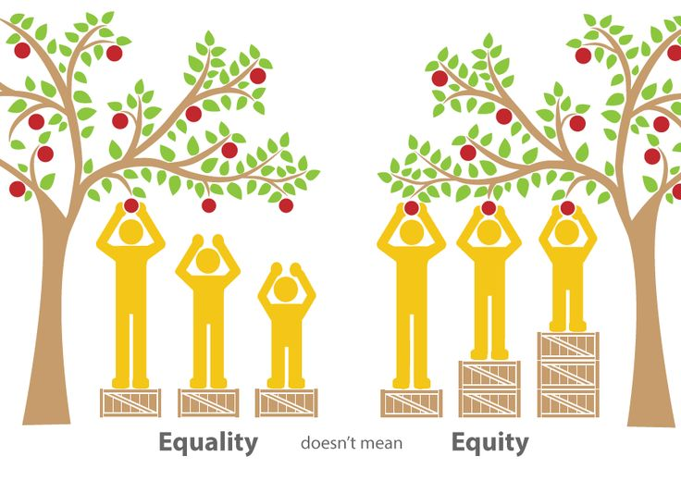
What does equity mean?
Notes:
Ruby

Slide 10
CCC Chancellor's Office Definition of Equity
For purposes of this plan, student equity is defined as helping students achieve equal outcomes on success indicators as compared to either their own percentage in the community or college student body, or to other student groups.
Notes:
Ruby

Slide 11
Student Equity Plan Success Indicators
Access
ESL, Math, English Basic Skills Completion
Course Success/ Completion
Degree and Certificate Completion
Transfer
Notes:
Ruby

Slide 12
Foothill College Mission Statement
Believing a well-educated population is essential to sustaining and enhancing a democratic society, Foothill College offers programs and services that empower students to achieve their goals as members of the workforce, as future students and as global citizens. We work to obtain equity in achievement of student outcomes for all California student populations, and are guided by our core values of honesty, integrity, trust, openness, transparency, forgiveness, and sustainability.
Notes:
Ruby

Slide 13
Foothill Educational Master Plan Goals
These goals are approached in a way that exemplifies Foothill College’s culture of innovation and problem solving, with emphasis on eliminating disproportionate impact among student groups:
Create a culture of equity that promotes student success, particularly for underserved students.
Strengthen a sense of community and commitment to the College’s mission; expand participation from all constituencies in shared governance.
Recognize and support a campus culture that values ongoing improvement and stewardship of resources.
Notes:
Ruby

Slide 14
De Anza College Mission Statement
De Anza College provides an academically rich, multicultural learning environment that challenges students of every background to develop their intellect, character and abilities; to realize their goals; and to be socially responsible leaders in their communities, the nation and the world. The college engages students in creative work that demonstrates the knowledge, skills and attitudes contained within the college’s Institutional Core Competencies:
• Communication and expression
• Information literacy
• Physical/mental wellness and personal responsibility
• Civic capacity for global, cultural, social and environmental justice
• Critical thinking
Notes:
Mallory

Slide 15
De Anza’s Strategic Initiatives
Outreach
Individualized Attention to Student Retention and Success
Equity
Community and Civic Engagement
- Educational Master Plan, 2015-2020
Notes:
Mallory

Slide 16
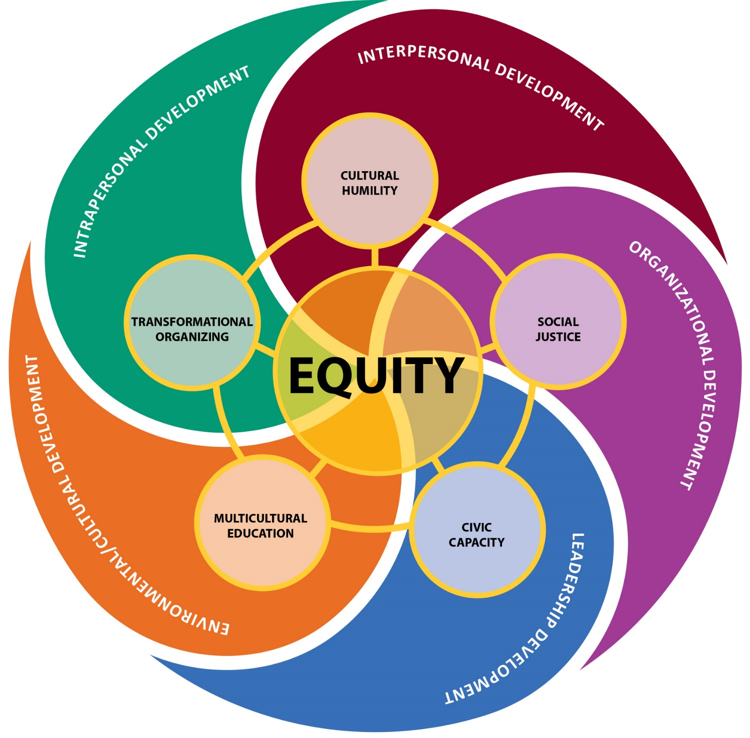
De Anza’s Equity Framework
- De Anza Educational Master Plan, 2015-2020
Notes:
Mallory

Slide 17
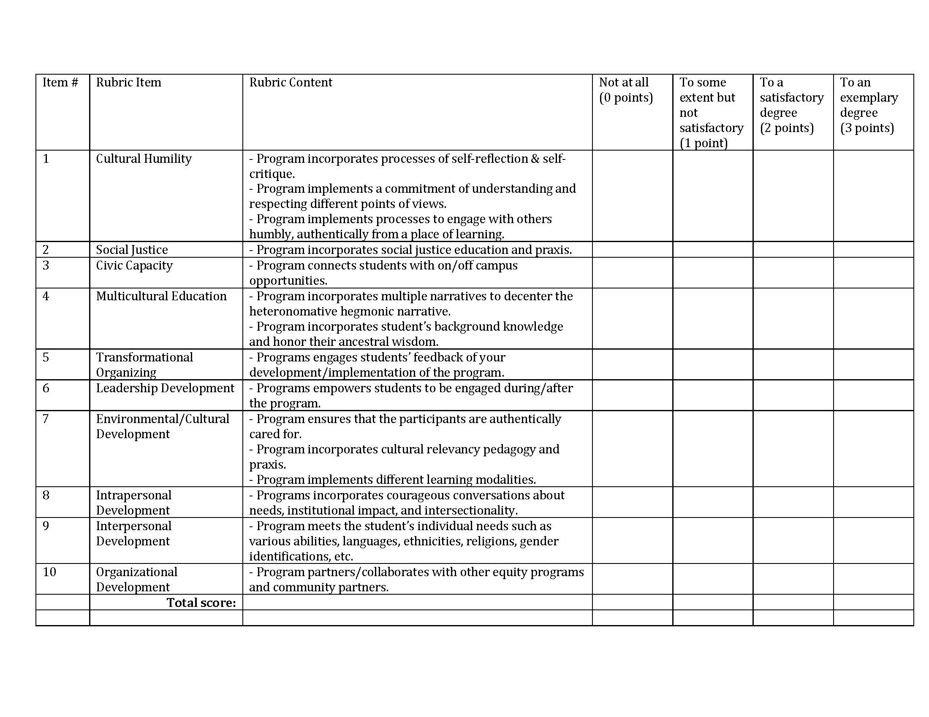
De Anza’s Equity-Driven Change Model Rubric
Notes:
Mallory

Slide 18
Activity #2
How could you apply an equity framework and/or the equity rubric to evaluate your own program area?
Notes:
Mallory

Slide 19
ACCJC Standards That Explicitly Mention Equity
I.B.1. The institution demonstrates a sustained, substantive and collegial dialog about student outcomes, student equity, academic quality, institutional effectiveness, and continuous improvement of student learning and achievement.
II.A.7. The institution effectively uses delivery modes, teaching methodologies and learning support services that reflect the diverse and changing needs of its students, in support of equity in success for all students.
III.A. 12. Through its policies and practices, the institution creates and maintains appropriate programs, practices, and services that support its diverse personnel. The institution regularly assesses its record in employment equity and diversity consistent with its mission.
Notes:
Andrew

Slide 20
Equity in the context of the Standards includes:
Academic quality
Student services
Human resources practices
Disaggregation of student learning outcomes data
Notes:
Andrew

Slide 21
Quality Focus Essay Requirements
Identify 2-3 areas for further study, improvement, and to enhance academic quality, institutional effectiveness, and excellence
Stemming from the action plans and become "action projects“
Focus on improving learning and achievement
Discuss in detail the identified areas to be acted upon, responsible parties, timeline, anticipated outcomes, and the impact on academic quality and institutional effectiveness.
5,000 word limit
Action projects become multi-year, long-term directions for improvement and commitment to excellence
Focal point for the Midterm Report
Notes:
Andrew

Slide 22
QFE Example – Chaffey College
Goal 3 (G3): Create new supports and interventions to close the achievement­ gap for all disproportionally affected­ groups (students, staff, ­faculty, and administrators)­.
Objective 1 (G3.O1):
Identify and explore the institutional barriers hindering equity
Create opportunities for open and regular dialog about issues hindering equity
Create a core competency explicitly addressing equity
Notes:
Andrew

Slide 23
QFE – City College of San Francisco
Action Project 2. The action project to close achievement gaps in Basic Skills is taken from the “ESL and Basic Skills Completion” section of the College’s 2015-16 Student Equity Plan. The College chose this project for two reasons. First, the Basic Skills portion of the Equity Plan focuses on making lasting institutional-level changes to the delivery of basic skills that have the potential to benefit students beyond the life of the grant funds. Second, the College is hoping to add SLO data to equity planning, and pursuing this project has the potential to help the College identify the best ways to combine SLO and achievement data to close achievement gaps.
Building an ESL Mission Pathway that increases the number of underrepresented minority students who move from noncredit ESL to credit coursework (certificate, degree, or transfer programs)
Expanding English Sequence Acceleration to increase the number of all students completing the English basic skills sequence
Creating a Developmental Math Community of Practice that closes achievement gaps through a community of practice that draws on and translates experiences from a Summer Math Academy for African American, Latino, Pacific Islander, and Native American students
Notes:
Andrew

Slide 24
QFE– Santa Monica College
Action Project | Related Plans for improvement emerging from self- | Standards
 | evaluation
Integrated Student | To reduce equity gaps in student achievement as | IIA3
Equity and Success | identified in Student Equity Plan, Program Review, | IIA8
Plan | and Institutional Effectiveness reports
 | Reduce time to completion of academic goals | IIA5
 | Ongoing implementation and assessment of Student | IIA7
 | Equity Plan
 | Use contextualized instruction and other evidence- | IIA11
 | based methods from the Basic Skills Innovation and
 | Transformation project to improve success
 | Hire a diverse faculty and staff that reflects the SMC | IIIA10
 | student population
 | Prioritize the Student Equity and Success plan in the | IVA1
 | new strategic planning cycle to be initiated in Fall
 | 2016
 | Research, implement, and evaluate a single tutoring | IIB3
 | tracking and assessment system college-wide
Notes:
Andrew

Slide 25
QFE Discussion Item
Institutional Core Competency: My experience at this college contributed to my ability to solve numerical problems.
 | Very much/ Quite a bit | Percent | Some/ Very little/ Don’t know | Percent | Total
Targeted | 187 | 68% | 87 | 32% | 264
Not Targeted | 518 | 59% | 364 | 41% | 829
Institutional Core Competency: My experience at this college contributed to my ability to use computing and information technology.
 | Very much/ Quite a bit | Percent | Some/ Very little/ Don’t know | Percent | Total
Targeted | 174 | 63% | 100 | 36% | 274
Not Targeted | 535 | 60% | 353 | 39% | 888
Notes:
Mallory

Slide 26
Activity #3
What do these data tell you?
What questions/interpretations/assumptions emerge from these data?
What other information might be helpful?
What groups would you want to consult with?
Based on these data, what types of activities might you propose for the QFE?
What should our goals be?
Who (people, departments) should be involved?
Notes:
Mallory

Slide 27
The Role of Program Review in Accreditation
Mentioned in several Standards
Part of an integrated planning process
Connects college goals to student learning (course and program outcomes)
Might include institutional and program standards for student achievement (a minimum or floor).
Notes:
Mallory

Slide 28
Foothill’s Program Review Template
1G. Equity: One of the goals of the College’s Student Equity plan is to close the performance gap for disproportionately impacted students, including African-­‐American, Hispanic/Latino, and Filipinos/Pacific Islanders. If the course success rates for these students (or other groups not listed above, such as foster youth, veterans, and students with disabilities) is below that of the College, what is your program doing to address this?
Notes:
Ruby

Slide 29
De Anza’s Program Review Prompts
1. What progress or achievement has the program made relative to the plans stated in your program’s Comprehensive Program Review towards decreasing the student equity gap?
2. What progress or achievement has the program made relative to the plans stated in your departmental Equity Plan?
Notes:
Ruby

Slide 30
Sample Program Review Response: Fhdaeology Department
Our online classes are the most in need of more tutorial services but that is a college wide problem, which has yet to be systematically addressed.
We have had success and improved results in objective online tests by opening the testing window from one hour to two-­‐three hours.
Notes:
Andrew

Slide 31
Activity #4 – Providing Constructive Feedback on the Equity Agenda of Fhdaeology Department
What additional data or information would be helpful for you to see?
What suggestions would you give to this department?
What resources might they request?
What might you see in their program outcomes disaggregated by online/face to face?
Notes:
Andrew

Slide 32
Summary – did we help you …
Develop an understanding of how equity is included in the accreditation Standards?
Develop knowledge of the potential relationship between equity, program review, and accreditation?
Develop an understanding of how an equity agenda can be incorporated into the Quality Focus Essay (QFE)?
Notes:
Andrew

Slide 33

Questions

