Slide 1

Program Review
Advisory Council

Slide 2
Program Review Visual Timeline and Due Dates
Month | Due Date | Action | Who is Responsible
September | 9-30-19 | Notification to Deans, Academic Senate, and Classified Senate Requesting Writers and Readers | Office of Instruction
October | 10-25-19 | Deans send confirmation of the Writers to the Office of Instruction | Deans & AVPs
 | 10-30-19 | Orientation and Training of the Writers | Office of Instruction
November | 11-1-19 | Writer(s) Draft the Self-Study Report - Start 11-1-19 to 2-28-20 | Writers
 | 11-8-19 | Confirmation of the Readers from Academic and Classified Senates | Academic Senate Classified Senate
 | 11-22-19 | Orientation and Training of the Readers | Office of Instruction Readers
January | 1-17-20 | Section A-D in the Self-Study Template is due to the Dean for review and feedback | Writer
 | 2-7-20 | Deans provide feedback to the Writer(s) on Section A-D of the Self-Study Template | Deans & AVPs
February | 2-29-20 | Final Draft (All Sections) of the Program Review Template is Due | Writer
March | 3-2-20 | Readers are provided the Program Review Template and the PR Evaluation Rubric to begin the evaluation | Office of Instruction
 | 3-2-20 | Readers begin the evaluation of the Program Review Template | Readers
April | 4-3-20 | Readers Complete the Evaluation and Submit their Final Rubric | Readers
 | 4-15-20 | PowerPoint Presentation Due to the Office of Instruction | Writers
April/May | TBD | College Council Reviews Programs' Self-Study Reports and Presentations | The College Council

Slide 3
Program Review 2019-2020 Appointment of Roles Form
Program Name | Faculty Reader from Division | Faculty Reader at- Large | Classified Staff at- Large | Dean or AVP | IR Coach
Chemistry | Shaelyn St Onge-Cole | David McCormick | Josh Pelletier | Ram Subramaniam | Doreen F
Dental Assisting | Anand Venkataraman | Jay Patyk | Manuel Diaz-Alvares | Ram Subramaniam | Lisa L
Engineering | Ronald Painter | Voltaire Villanueva | Alfred Guzman | Ram Subramaniam | Doreen F
Geography | Kerri Ryer | Geoff Mathews | Eric Hoppe | Kurt Hueg | Lara T
Humanities | Joe Woolcock |  | Julie Ceballos | Kurt Hueg | Lara T
Music Tech | Carolyn Brown | Brian Evans | Christine Mangiameli | Debbie Lee | Doreen F
Theater Arts & Theater Tech | Elizabeth Barkley | Karen Erickson | Jerry Robredo | Debbie Lee | Lisa L
Pharmacy Tech | Lisa Schulthaeis | Hilary Gomes | Alfred Guzman | Ram Subramaniam | Lisa L
Respiratory Therapy | Kathy Armstrong | Hilda Fernandez | Hayley Davidson | Ram Subramaniam | Lisa L
Spanish |  | Mary Thomas | Alejandro Favela | Valerie Fong | Doreen F

Slide 4
Preparing and Presenting the Template PowerPoint to The Advisory Council
Programs under review presenting to the Advisory Council is part of the shared governance process and is a part of ensuring compliance with the accreditation process. The Advisory Council’s role is to hold programs’ accountable to critical engagement as they participate in the program review process. The presentation should provide The Advisory Council with
an ability to understand the emergent themes, issues, and or needs being experienced by programs under review
an overview about how the program contributes to the College mission and makes a difference for the students’ it serves
an understanding of the individual program’s areas of improvement as well as the overall weaknesses across all programs under review
Presenting also provides the program the opportunity to
Tell the story of the programs’ strengths and ask for the resources/help needed to continue great work, fix areas of weakness, and/or to scale

Slide 5
Presentation to Council
The Advisory Council presentations will be conducted in 20 minute intervals during two meeting sessions.
Writer presentation will be no longer than 10 minutes with an additional 10 minutes for Questions and Answers
The Advisory Council requests program presenters use the template provided, with no additional or deleted slides, which will be strictly followed due to the number of presentations and to allow for questions during the time allotted.

Slide 6
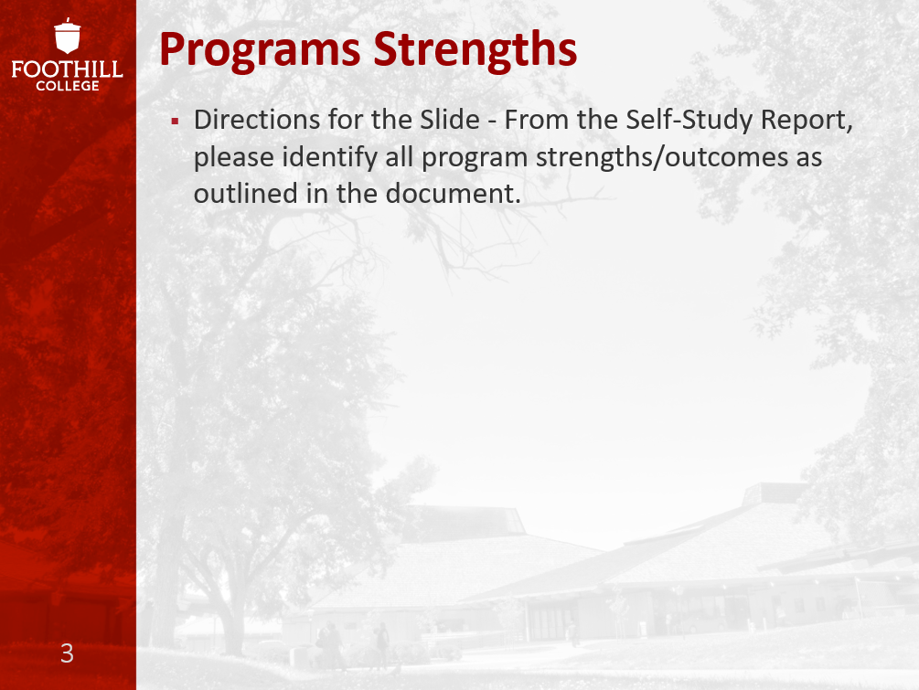
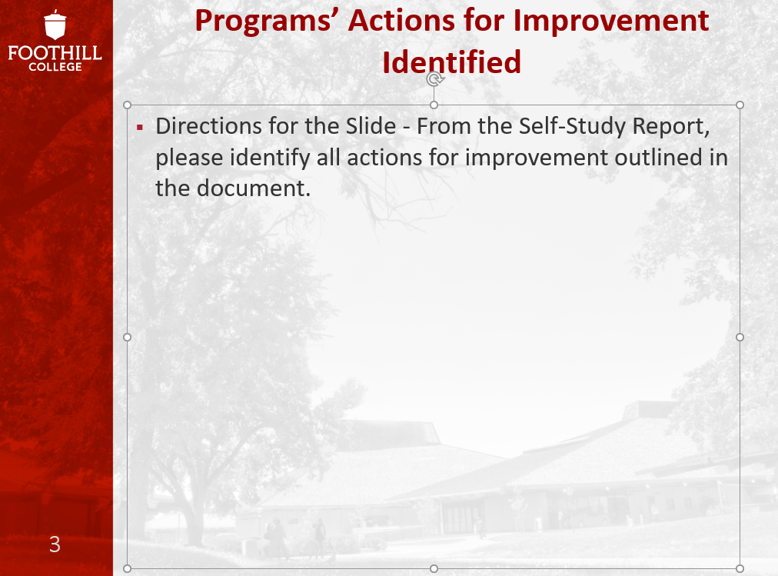
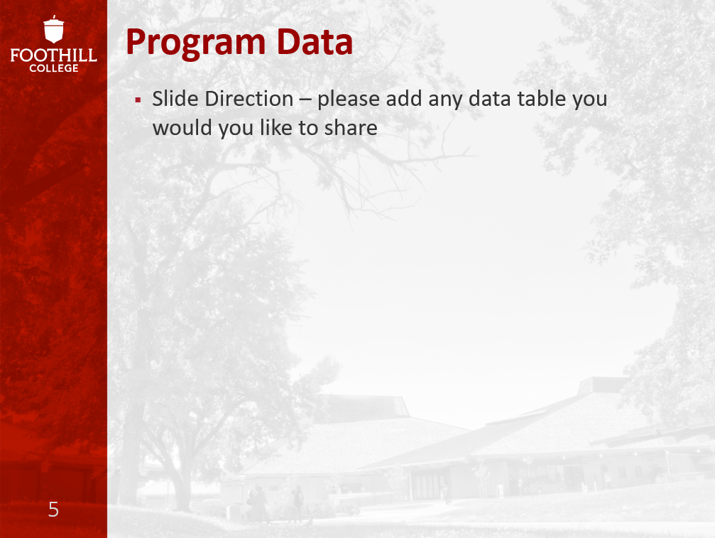

Advisory Council PowerPoint Template

Slide 7
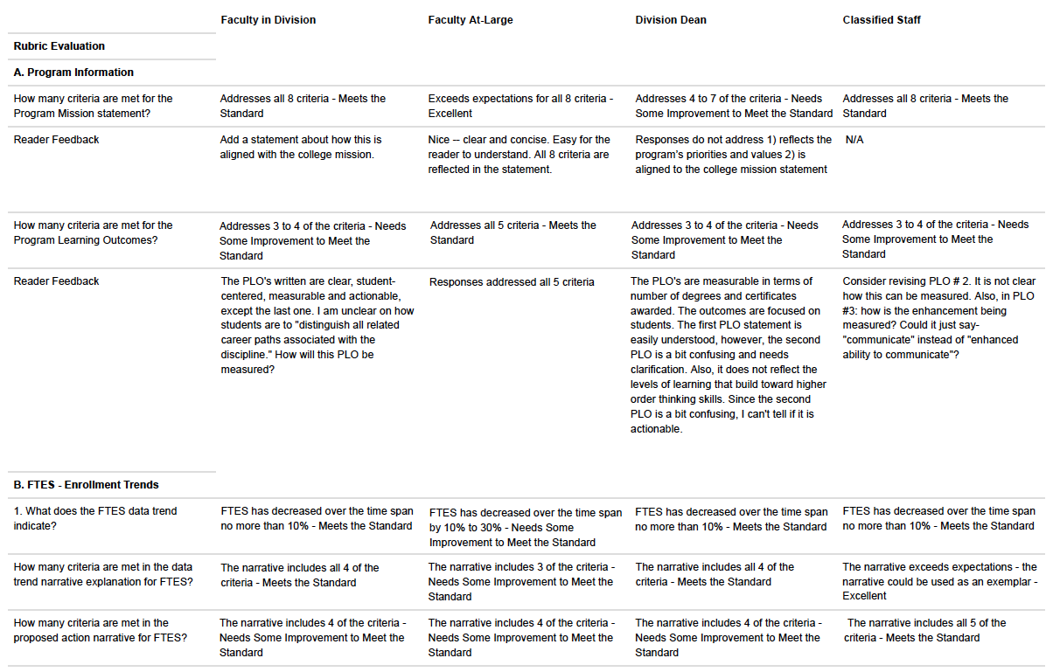
Condensed Outcome Rubric Summary

