Slide 1
Budget Update Bret Watson VP Finance & Administrative Services
October 5, 2018

Slide 2
Highlights
Background Regarding Reductions
Reductions by Division
Guiding Principles for Phase II Budget Reductions
Dates and Next Steps

Slide 3
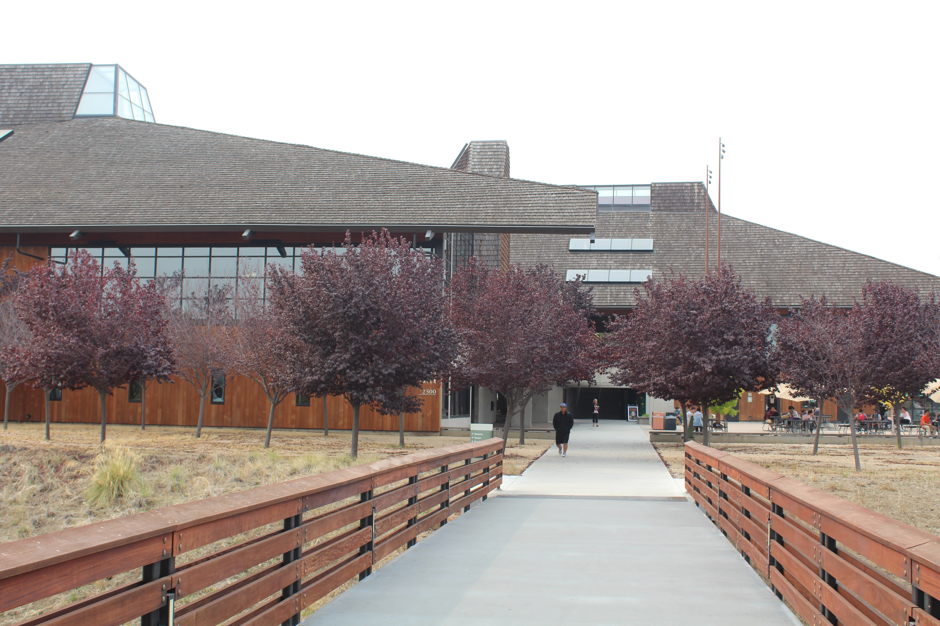
Our Mission
Believing a well-educated population is essential to sustaining and enhancing a democratic society, Foothill College offers programs and services that empower students to achieve their goals as members of the workforce, as future students, and as global citizens. We work to obtain equity in achievement of student outcomes for all California student populations, and are guided by our core values of honesty, integrity, trust, openness, transparency, forgiveness, and sustainability. Foothill College offers associate degrees and certificates in multiple disciplines, and a baccalaureate degree in dental hygiene.

Slide 4
Background
2017-18: District started with a -$10 million structural deficit http://business.fhda.edu/budget/annual-budget-and-quarterly-report.html
District enrollment decreased 1,484 Resident FTES = approx. -$7.6 million
Total ongoing structural deficit was estimated at $17.6 million

Slide 5
Resident FTES (2009-10 through 2017-18)

Slide 6
Enrollment
Resident FTES | 2016/17 | Final 2017/18 | Total | Percent
Foothill | 10,626.98 | 10,160.30 | -466.68 | -4.39%
De Anza | 15,340.54 | 14,323.42 | -1,017.12 | -6.63%
Total | 25,967.52 | 24,483.72 | -1,483.80 | -5.71%
Non-Resident FTES | 2016/17 | Final 2017/18 | Total | Percent
Foothill | 1,756.99 | 1,673.03 | -83.96 | -4.78%
De Anza | 2,856.76 | 2,768.17 | -88.59 | -3.10%
Total | 4,613.75 | 4,441.20 | -172.55 | -3.74%
Grand Total | 30,581.27 | 28,924.92 | -1,656.35 | -5.42%
Foothill’s decline in FTES is due to exclusion of ISA’s programs: Non-ISA enrollment was up 153 FTES or +1.53% compared to 2016/17
Productivity: 474

Slide 7
Assumptions/Unknowns
Supplementary Retirement Plan (SRP)
Future Enrollment/FTES
New Funding Formula Uncertainty

Slide 8
Budget Reduction Plan
District Budget Reduction Strategy reflects a total of -$17.6 million in cutshttp://business.fhda.edu/budget/annual-budget-and-quarterly-report.html
-$2M for 17/18, -$3M for 18/19, & -$12.6M for 19/20
Distribution of reductions is (35% Foothill, 50% De Anza, & 15% District)
Foothill’s share of the total reduction is $6.16M

Slide 9
Phase I Budget Reductions
Foothill College Budget Reductions for Years 1 & 2, were implemented July 1, 2018
Foothill College target was -$1,750,000
Foothill College used 8 Guiding Principles for Phase I
Actual reductions submitted in June 2018 for Phase I was -$1,751,236

Slide 10
Phase II Budget Reductions
Foothill College Budget Reductions target for Year 3 is -$4,408,764
Reduction List is due to District on November 2, 2018
Implementation date is July 1, 2019

Slide 11
Reduction Preview
No program eliminations
Information is reflected by division
No detail regarding position number, name, position title, etc.

Slide 12
Finance, Marketing & President’s Office: Phase I
Moved one filled Classified (ACE) position (.5 FTE) to the Self Sustaining Fund 115
Moved one filled Administrator position (.3 FTE) to the Self Sustaining Fund 115
Eliminated one vacant Classified (ACE) position (.79 FTE) General Fund and (.21 FTE) Self Sustaining Fund
Total Reductions = $180,049

Slide 13
Finance, Marketing & President’s Office: Phase II
Move two Classified ACE positions, one filled (.25 FTE) to Self Sustaining Fund 115 and one vacant (.50 FTE) to the Workforce Development Program
Move one filled Classified Teamsters position (.5 FTE) to Self Sustaining Fund
Eliminate two Administration positions (2.0 FTE); one filled and one vacant
Eliminate two and a half filled Classified ACE positions (2.5 FTE)
Subtotal = $793,927
“B” Budget permanent reduction
Subtotal = $115,000
Total Reductions = $908,927

Slide 14
Finance, Marketing & President’s Office
Phase I reductions = $180,049
Phase II reductions = $908,927
Reorg. Additions
Add one Administrator position (1.0 FTE)
Add one Classified Teamsters position (1.0 FTE)
Reorganization costs = -$324,281
Total reductions = $764,696

Slide 15
Instruction: Phase I
Moved one vacant Administrator position (1.0 FTE) to the Self Sustaining Fund and to Strong Workforce
Eliminated one vacant Classified ACE position (1.0 FTE)
Eliminated nine vacant Faculty Assoc. positions (9.0 FTE)
Total Reductions = $1,497,899

Slide 16
Instruction: Phase II
Move one filled Classified ACE position (1.0 FTE) to the Foundation
Eliminate one filled Administrator position (1.0 FTE)
Eliminate two vacant Classified ACE positions (2.0 FTE) and nine and one-half filled Classified ACE positions (8.88 FTE) General Fund & (.62 FTE) Restricted Fund
Eliminate 12 vacant Faculty Assoc. positions (12.0 FTE)
Subtotal = $2,526,967
“B” Budget reduction
Subtotal = $100,000
Total Reductions = $2,626,967

Slide 17
Instruction
Phase I Total Reductions = $1,497,899
Phase II Total Reductions = $2,626,967
Reorg. Additions
Add one Classified ACE position (1.0 FTE)
Reclass for one filled Administrator position
Reorganization costs = -$110,711
Total Reductions = $4,014,155

Slide 18
Student Services: Phase I
Moved two filled Classified ACE positions (.25 FTE) to the Self Sustaining Fund 115 and (.50 FTE) to the Campus Center Fund 128
Eliminated one vacant Classified ACE position (.06 FTE) General Fund and (.94 FTE) SSSP
Total Reductions = $73,287

Slide 19
Student Services: Phase II
Move two vacant Classified ACE positions (2.0 FTE) to SSSP
Move three filled Classified ACE positions (3.0 FTE) to SSSP and one filled Classified ACE position (.25 FTE) to Student Accounts
Move one filled Faculty Assoc. position (.75 FTE) to SSSP
Eliminate one filled Administrator position (1.0 FTE)
Eliminate three filled Classified ACE positions (2.77 FTE) General Fund and (.23 FTE) Restricted Fund
Eliminate one vacant Classified Teamsters position (1.0 FTE)
Total Reductions = $1,324,992

Slide 20
Student Services
Phase I Reductions = $73,287
Phase II Reductions = $1,324,992
Total Reductions = $1,398,279

Slide 21
Division Totals
Division | Total
Finance, Marketing & President’s Office | $764,696
Instruction | $4,014,155
Student Services | $1,398,279
Subtotal | $6,177,130
Target | $6,160,000
Balance | $17,130

Slide 22
Positions/FTEs to be Eliminated
Employee Type | Vacant | Filled | Reorg | Total
Administration | 1.0 | 3.0 | -1.0 | 3.0
Classified ACE | 5.5 | 15 | -1.0 | 19.5
Classified Teamsters | 1.0 |  | -1.0 | 0.0
Faculty Assoc. | 21.0 | 0.0 | 0.0 | 21.0
Total | 28.5 | 18.0 | -3.0 | 43.5

Slide 23
Eight Proposed Guiding Principles for Reductions: Phase Two
1) Preserve Quality Education
2) Follow College’s Core Values
3) Strategic Enrollment Growth
4) Cabinet Review/Approval
5) Minimize the number of lay-offs and (when possible) the effects on employees, including racial/ethnic impact, and in accordance with collective bargaining agreements, while improving efficiency and being strategic in reorganization
6) Spending relates to strategic objectives
7) Shared Impact
8) Program Review/Elimination
Note: A letter and attachments were provided to the Governance Council dated Sept. 7, 2018 from President Thuy Nguyen regarding the details of the Eight Proposed Guiding Principles Phase Two

Slide 24
Minimizing Layoffs
Categorical Programs (SSSP, Student Equity, Strong Workforce)
Vacancies (full-time faculty, retirements & full-time classified vacancies)
“B” Budget
Self-Sustaining Fund (Rental Facilities/Fine Arts)
Campus Center Use Fees (Fund 128)
Foundation (KCI Program)
Raise Printing Fees (Support Printing Services position)
Reduce release time, stipends, comp-time & overtime

Slide 25
Transfers & “B” Budget
Transfers to Other Funds = $1,272,295
“B” budget reductions = $215,000
Total = $1,487,295

Slide 26
Consultation: Participatory Governance and Town Halls
Round 1: Budget Reduction & Proposed Percentage Cuts in Each Division
September 14, 2017: Governance Summit —> present information about budget reductions percentages
November 8, 2017: Town hall at main campus (Hearthside)
November 30, 2017 (Sunnyvale) / December 5, 2017 (Hearthside): District town halls
November 1 & 15, 2017: PaRC regarding Proposed % Cuts in each Division
Round 2: Guiding Principles & Discussion by Divisions on Possible Budget Cuts
January 22, 2018: Cabinet retreat
January 25, 2018: Admin Council retreat
January 31, 2018: PaRC
Round 3: Finalize list of reductions for Year 1 & 2
March 22: Cabinet retreat
April 19: Town Hall
April 18 & 25: PaRC
April/May: Finalize list to District

Slide 27
Budget Reduction Phase II Timelines
Round 4: Guiding Principles for Phase II – Year 3 and Program Review
May 16, June 6 & June 20, 2018: PaRC develop/review Guiding Principles for Phase II
September 14, 2018: Governance Summit – approve Guiding Principles Phase II
October 5, 2018: new “Governance Council” Meeting-recommends Phase II Guiding Principles & program elimination criteria (1st reading)
October 19, 2018: “Governance Council” meeting – budget reduction list (2nd reading). Recommends on program elimination criteria (2nd/final reading)
October 24, 2018: Town hall on main campus
October 26, 2018: “Governance Council” meeting
November 2, 2018: “Governance Council” meeting – budget reduction list WITH program elimination list (FINAL recommendation)
November 2, 2018: FINAL DELIVERY TO DISTRICT

Slide 28
Recommendations Needed from the Council
Guiding Principles recommendation for approval
Nov. 2 – final recommendation for list of reductions to District
No Program Eliminations
No details for the eliminations until (Jan/Feb. 2019)
Town Hall meeting for October 24, 2018

Slide 29
Questions?

