Slide 1

VISION:
Core values
Purpose
Mission
STRATEGY:
Internal and External Assessment
Strategic Decisions and Objectives
TACTICS:
Specific Action Steps: who is to do what, by when, and how
FOOTHILL COLLEGE GOVERNANCE AND DECISION-MAKING MODEL
Mission (I’m) Possible Council (MIPC)
Educational Equity Master Plan (Strategic Vision for Equity)
Pres. Cabinet
Admn/Deans Councils
Acad/Classif Senates
ASFC
Planning committees
Task Forces
Workgroups
Programs
MIP-C’s charge in 13 Issues/55 Goals Task Force

Slide 2
Educational Equity Master Plan
Educational Master Plan
Strategic Vision for Equity
Goal B: Strategies B1: Encourage student participation in leadership and activities outside the classroom (including service/work-­‐based learning) that engages students with the College and the community. B2: Provide better onboarding, support and professional development for all college employees. B3: Encourage employee participation in leadership and activities that engages them with the College and the community. B4: Promote consistent and clear communication in order to create a more informed, cohesive and engaged community. B5: Increase lifelong learning opportunities for our community. B6: Promote decision-­‐making that respects the diverse needs of the entire college community.
Issue 5. Lack of sense of belonging, safety, and space allocation for students of color
Issue 6. Many programs perpetuate structural racism by failing to educate students in the history and ongoing racism implicit and explicit in their disciplines
Issue 7. Insufficient culturally responsive, relevant and sustaining pedagogy and other asset-based approaches in teaching and serving our students of color
Issue 8. Microaggressions and unconscious bias negatively affect experience and learning for students
Issue 9 Lack of a college-wide retention plan for students of color to progress through their academic career

Slide 3
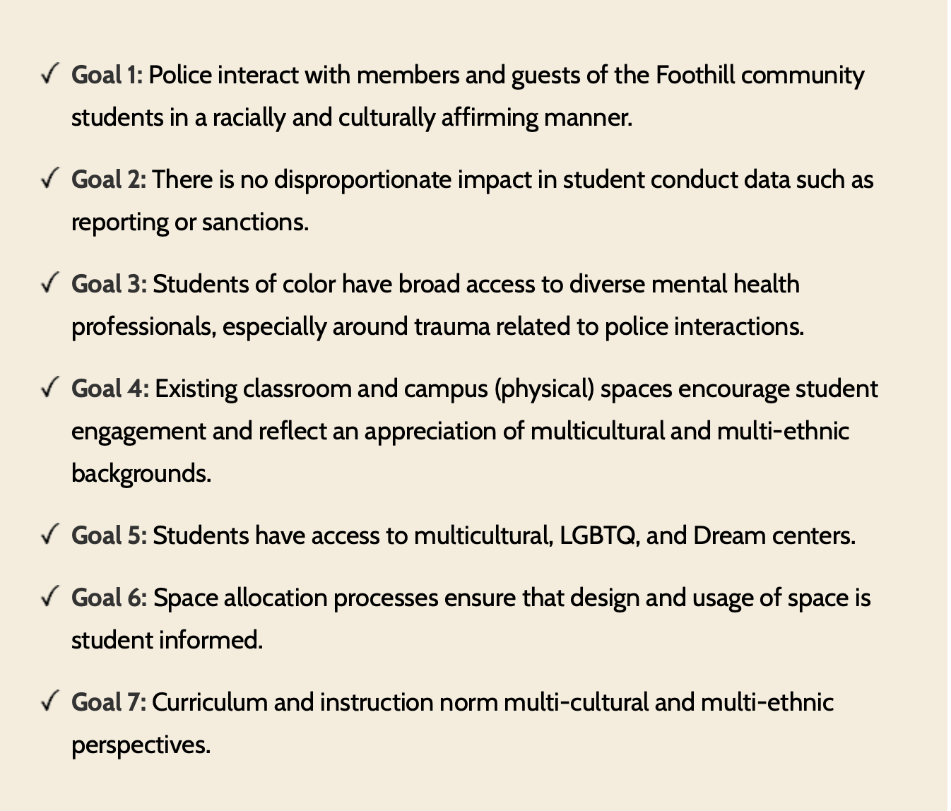
7 SVE Goals

Slide 4
Launch of Mentor Mindset Institute
THE WHAT: Kickoff Feb. 1
THE WHO
Series of workshops on strategies for establishing and invoking a mentor mindset in the college culture
Kickoff Feb. 1
Any interested employee or student who commits to ongoing coaching and attending the kickoff and multiple small group sessions and carries out the work
The team will work on developing a “Mentor Mindset” campus culture which is a mindset in which high standards in the classroom, office, and college are matched with a supportive social/emotional climate

