Slide 1
Art on Campus

Slide 2
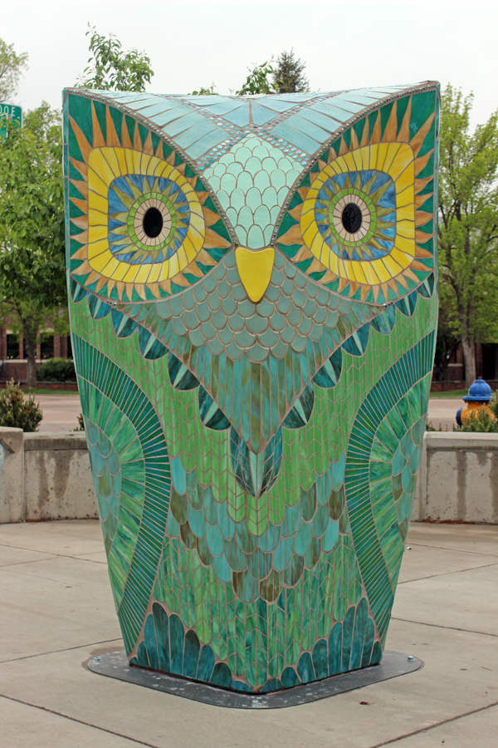
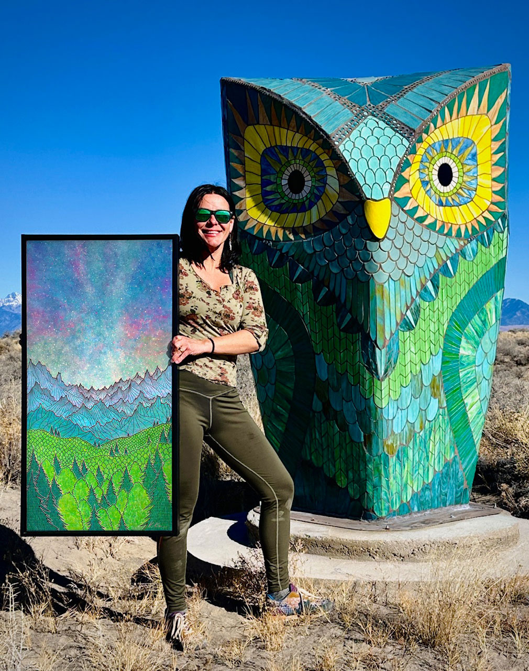
Kasia Polkowska and Kyle Cunnif - Artemis
Stained glass mosaic and ceramic tiles, 7 ft tall, $60,000
Notes:
Pagosa Springs, Colorado

Slide 3
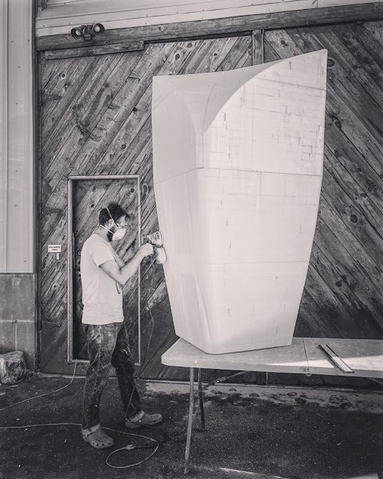
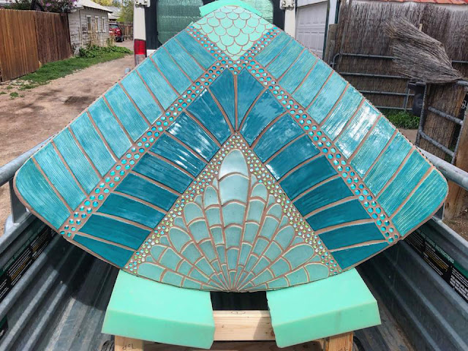
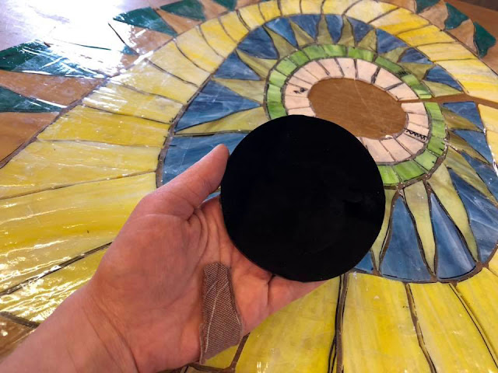
Kasia Polkowska and Kyle Cunnif - Artemis
Custom ceramic tiles and stained glass
Polystrene, mesh, and “exterior foam coat”
Notes:
the interior of the sculpture is created from polystyrene, mesh and a form of concrete called 'exterior foam coat'.

Slide 4
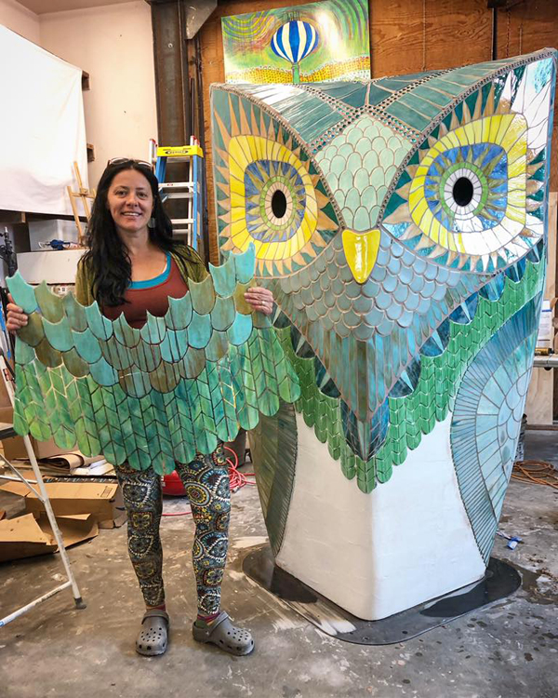
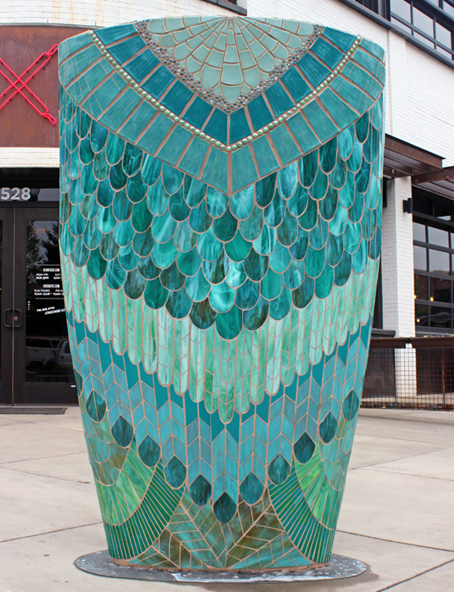
Kasia Polkowska and Kyle Cunnif - Artemis
Notes:
300 lbs
In a nutshell, the interior of the sculpture is created from polystyrene, mesh and a form of concrete called 'exterior foam coat’. For this project I created custom ceramic tiles for a portion of the sculpture. The rest of the mosaic was created with custom stained glass shapes. Each piece was cut and arranged by me.

Slide 5
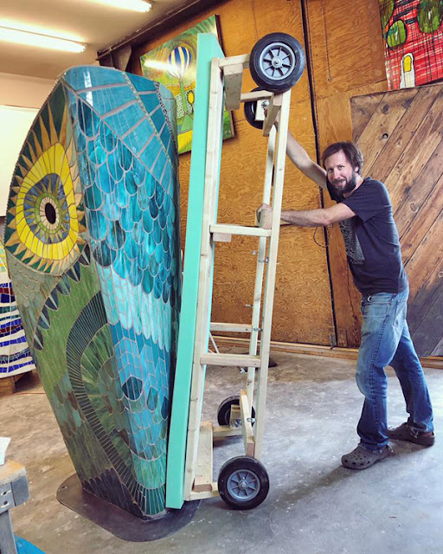
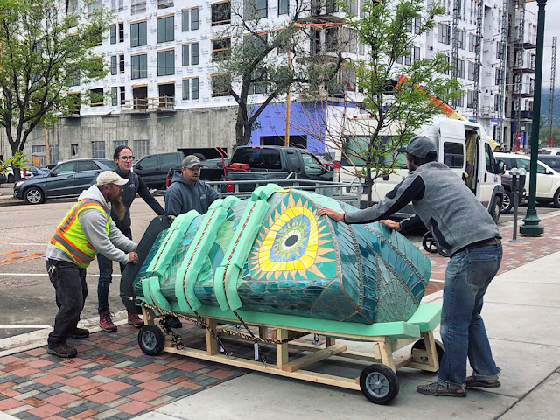
Kasia Polkowska and Kyle Cunnif - Artemis
Appx 300 lbs
Notes:
300 lbs
In a nutshell, the interior of the sculpture is created from polystyrene, mesh and a form of concrete called 'exterior foam coat’. For this project I created custom ceramic tiles for a portion of the sculpture. The rest of the mosaic was created with custom stained glass shapes. Each piece was cut and arranged by me.

Slide 6
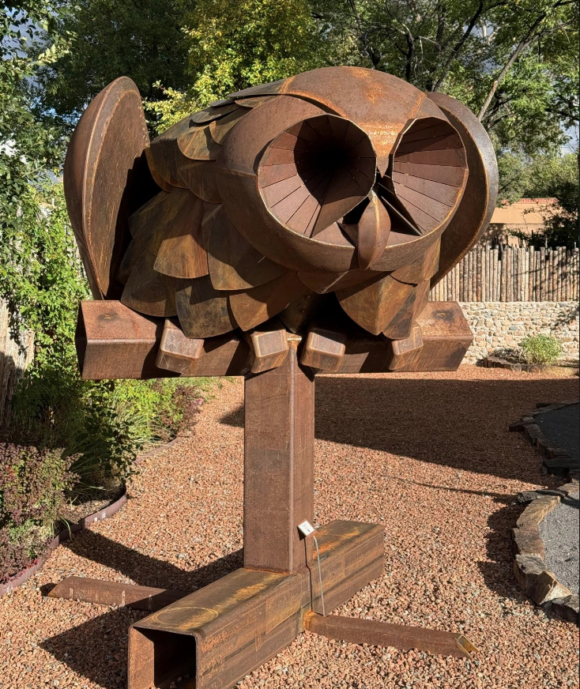
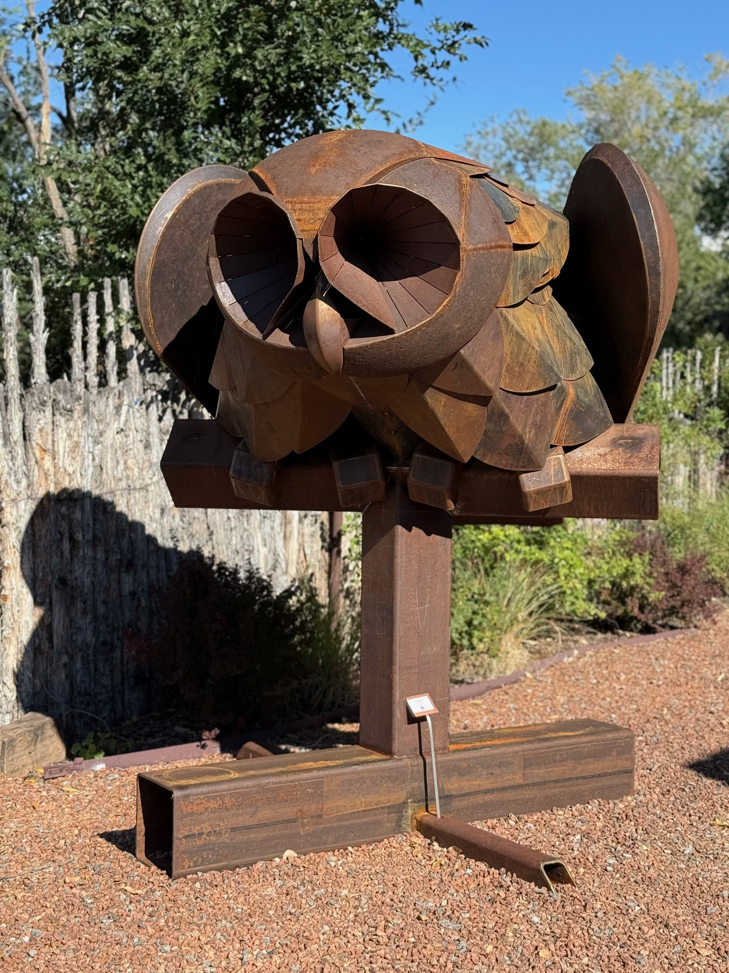
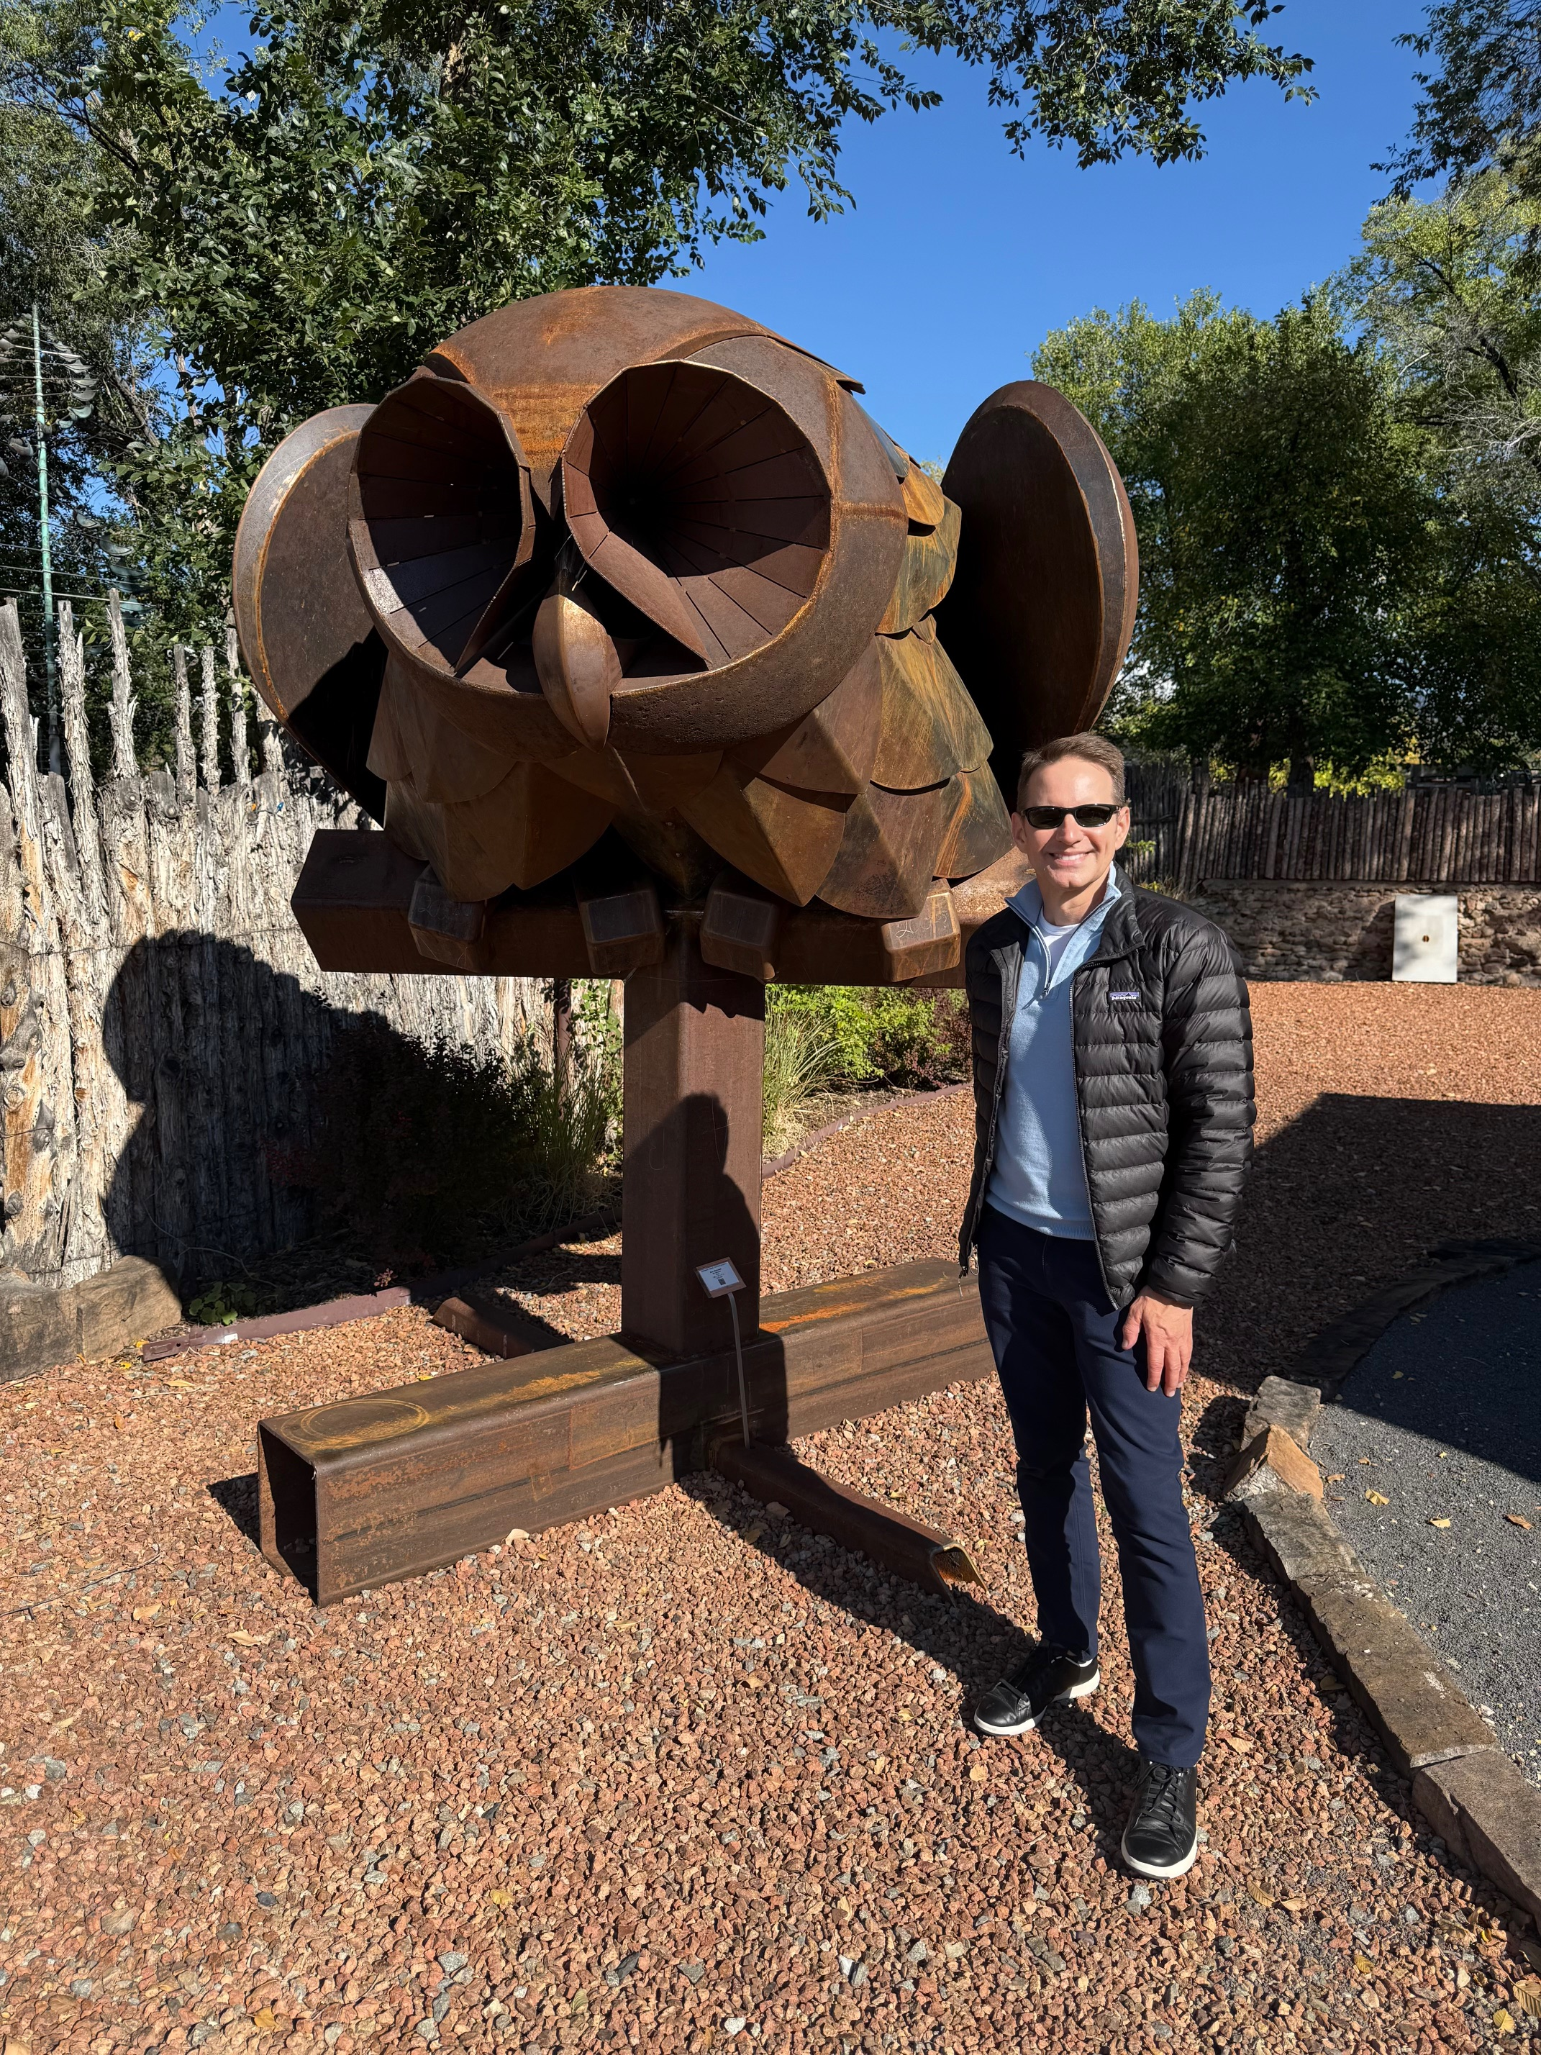
Eben Markowski – Silo Blossom, 2025
Steel, 100 x 125 x 77 in, $135,000

Slide 7
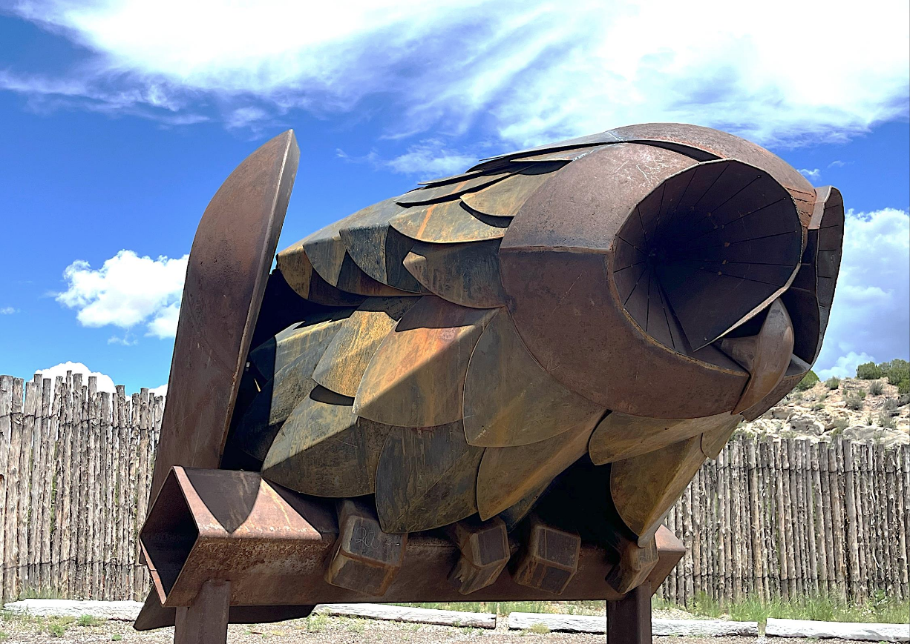
Eben Markowski – Silo Blossom, 2025
Steel, 100 x 125 x 77 in, $135,000

Slide 8
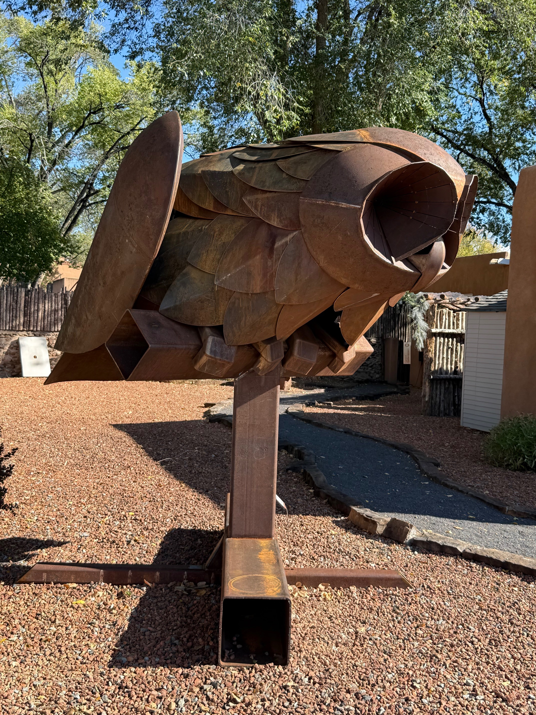
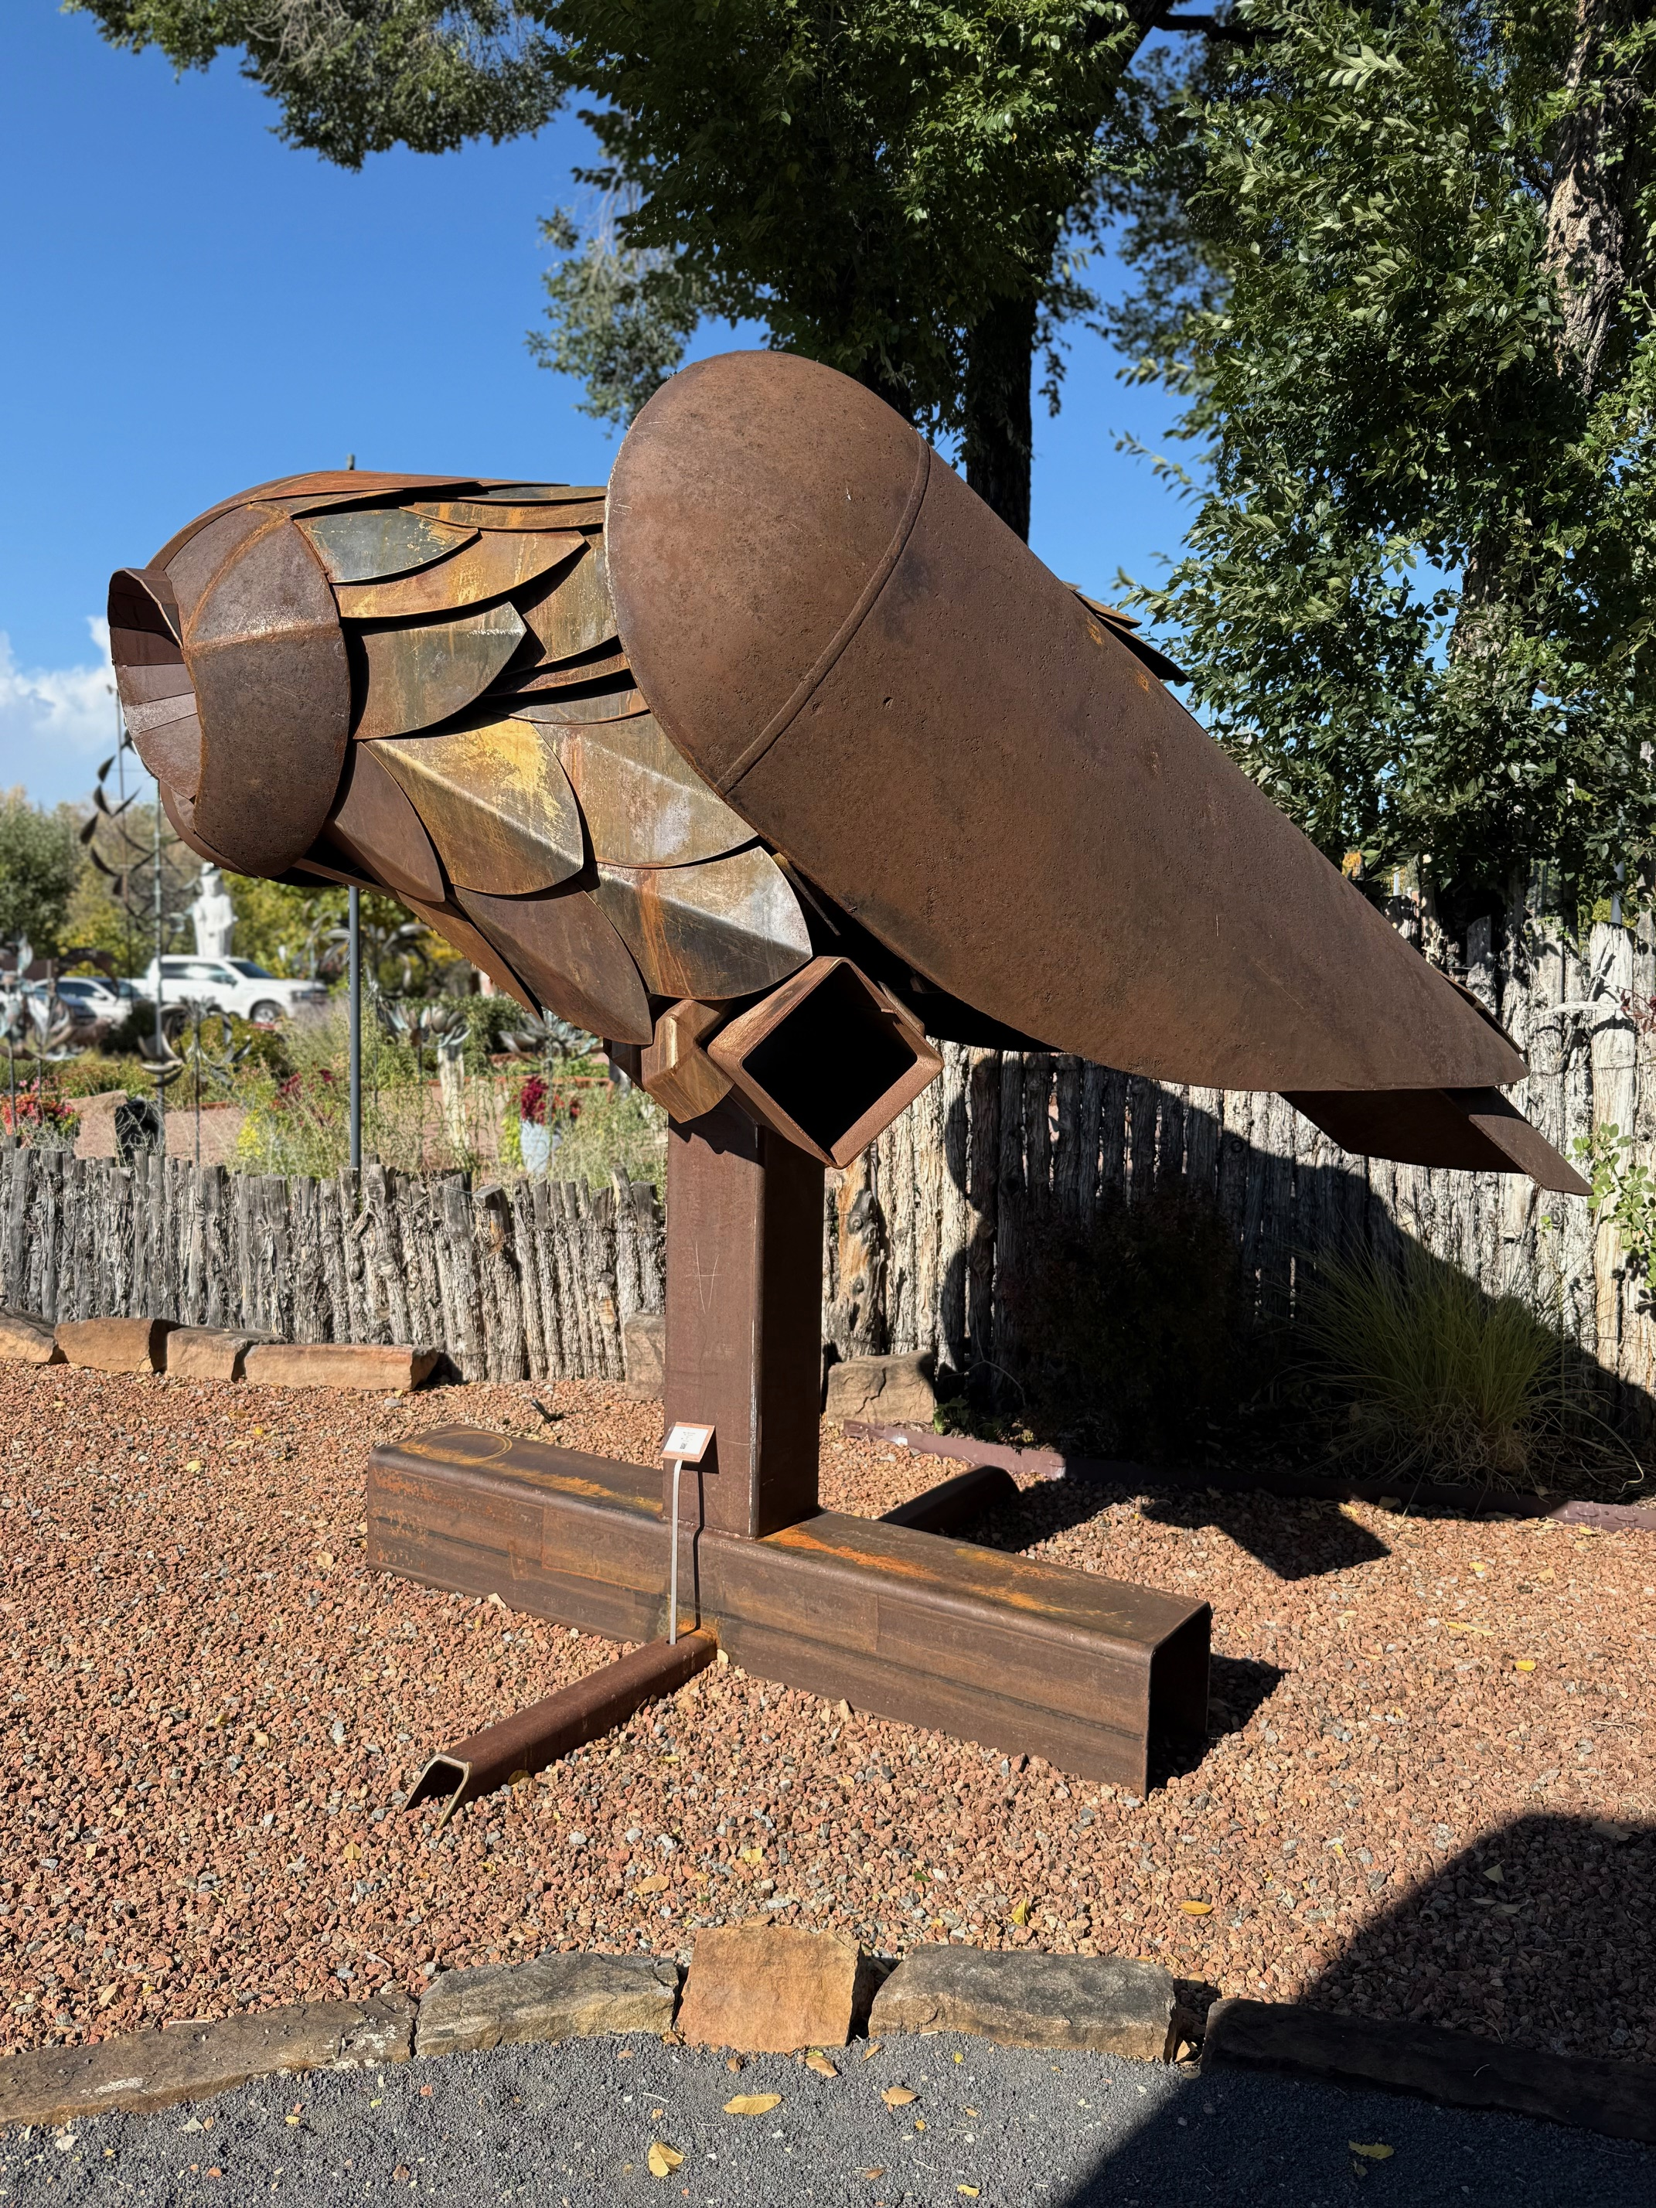
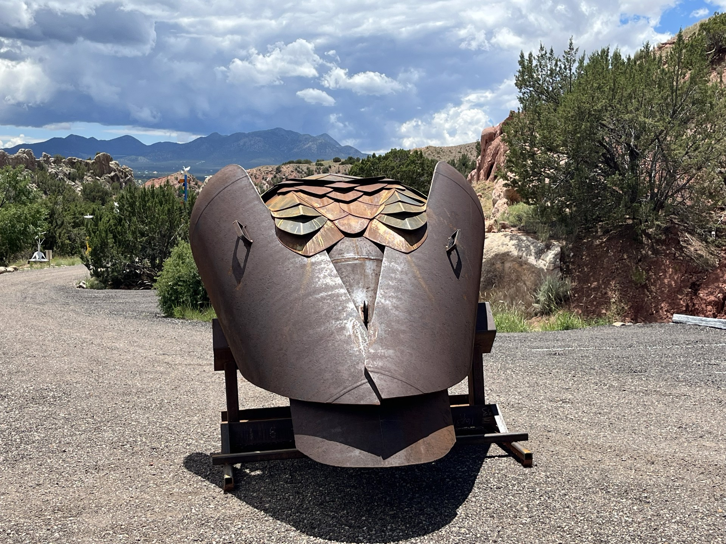
Eben Markowski – Silo Blossom, 2025
Steel, 100 x 125 x 77 in, $135,000

Slide 9
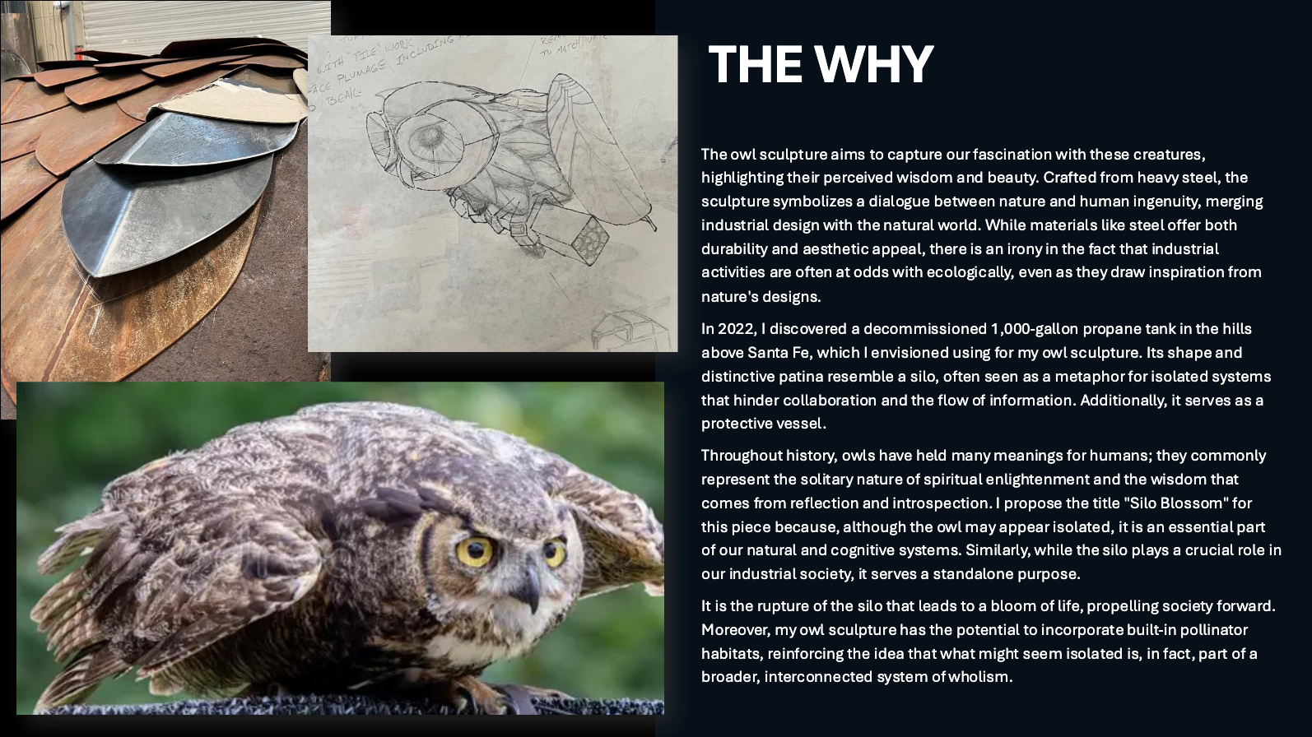
Eben Markowski – Silo Blossom, 2025

Slide 10
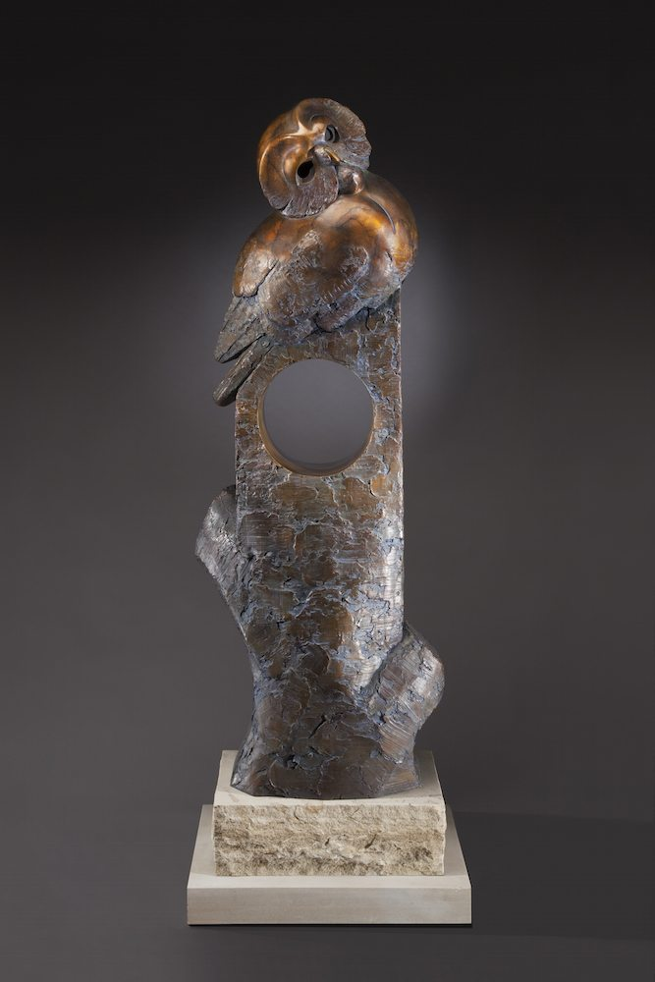
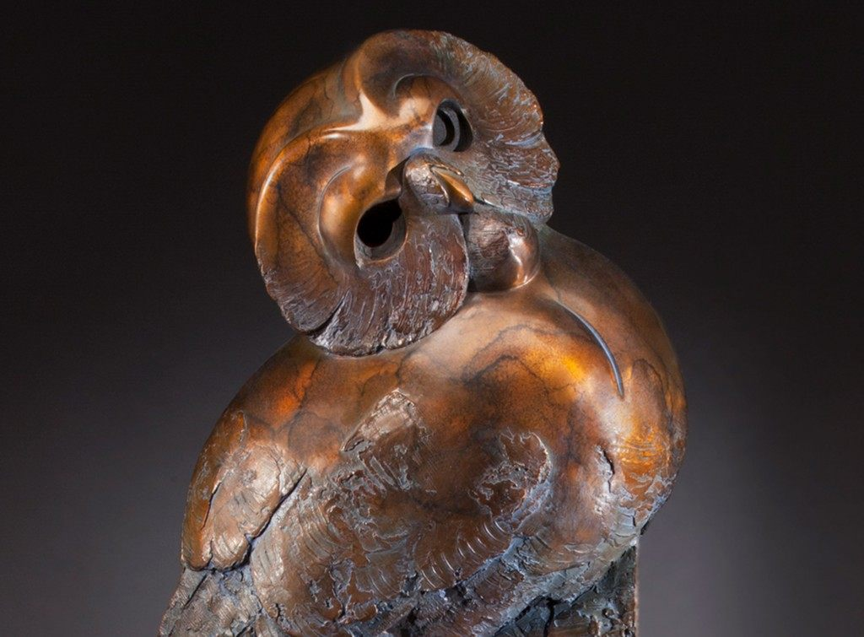
Tim Cherry – Housesitter (monumental)
Bronze 22"L x 65"H x 15"W $34,000
Notes:
https://timcherry.com
I chose the Saw-Whet Owl for its engaging, jovial attitude and abundance of curves and round masses. Always one of my favorite design elements, circles, is found throughout the sculpture. I was able to play with the negative space within which represents the nest. The smooth surface against the hard texture creates contrast and gives the sculpture a lasting interest. “House Sitter” is meant to engage the viewer and speak of curiosity.

Slide 11
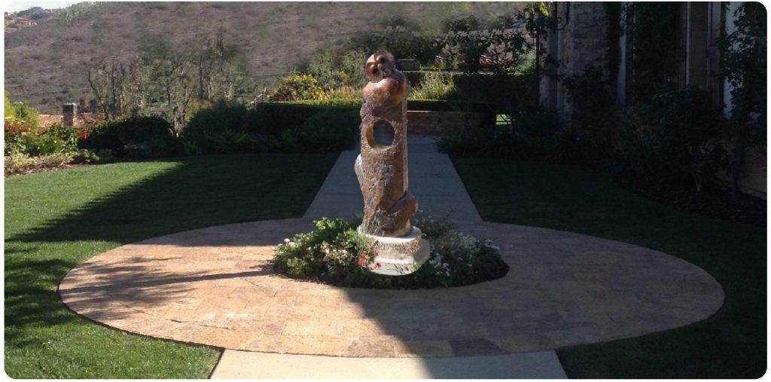
Tim Cherry – Housesitter (monumental)
Bronze 22"L x 65"H x 15"W $34,000
Notes:
https://timcherry.com
https://canyoncontemporary.com/art/silo-blossom-steel-150000-by-eben-markowski

Slide 12
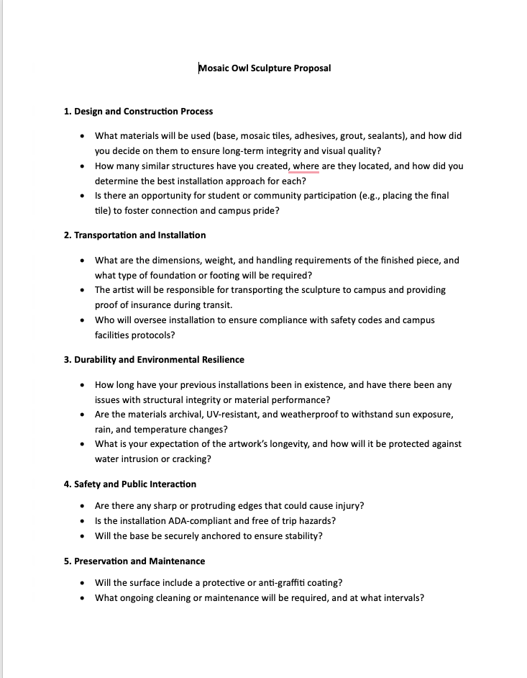
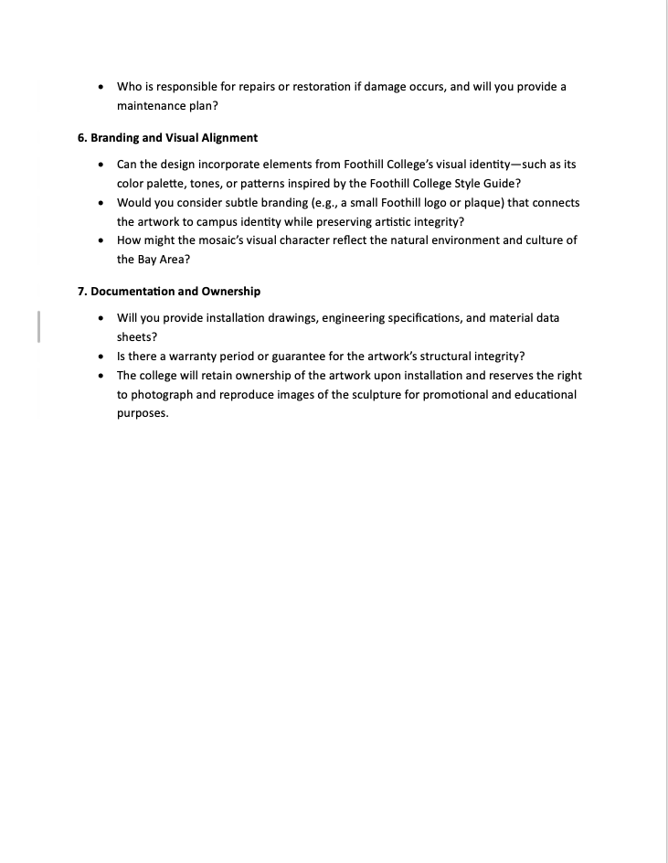
Kasia Polkowska and Kyle Cunnif - Artemis
Notes:
Pagosa Springs, Colorado

