Slide 1
Mission Statement Review Committee: Context and History
At the October 7th MIPC meeting, the council decided to review, and possibly revise, the current mission statement during this accreditation cycle.
A small initial group formed to start the work (Elaine Kuo, Janie Garcia, Jordan Fong, and Josh Pelletier) and to create a survey to gather feedback about the current mission statement.
Results from the first survey were shared at MIPC in January, and a larger group formed to review the feedback and consider making changes to the mission.

Slide 2
Believing a well-educated population is essential to sustaining and enhancing a democratic society, Foothill College offers programs and services that empower students to achieve their goals as members of the workforce, as future students, and as global citizens. We work to obtain equity in achievement of student outcomes for all California student populations, and are guided by our core values of honesty, integrity, trust, openness, transparency, forgiveness, and sustainability. Foothill College offers associate degrees and certificates in multiple disciplines, and a baccalaureate degree in dental hygiene.

Slide 3
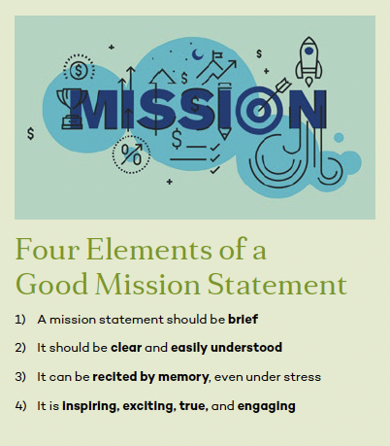
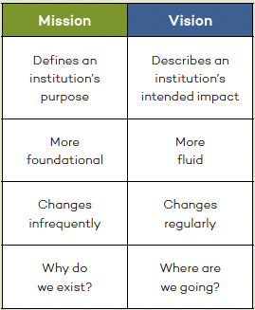
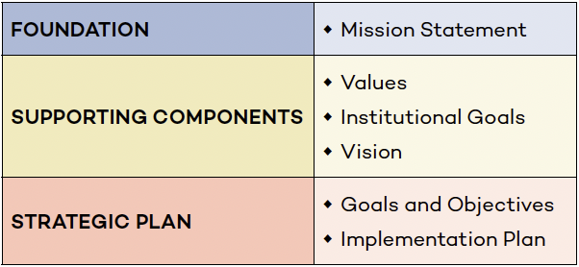
Mission Statement Review Committee: Context and History
The first survey asked people to evaluate the current mission based on guidance provided by the Society for College and University Planning (SCUP)

Slide 4
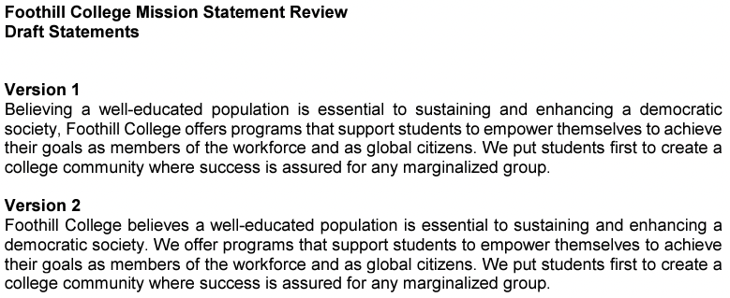
Mission Statement Review Committee: Context and History
Following this first survey, the Mission Review Committee expanded its membership to include all constituent groups (full list on website).
This expanded committee met during the winter quarter, decided that revisions were necessary, and produced two draft statements for the college to consider:
  Removed degrees
  Removed values
  Revised concluding sentence based on SVE wording: “create a college community where success is not predictable by race.”

Slide 5
Mission Statement Review Committee: Context and History
Despite the committee struggling to agree about how to express who we are to the public and to our students, we do share a vision of Foothill College:
  Quality education isn’t just about student success in the classroom; it involves personal growth and discovery, building leadership skills, and learning to be a responsible citizen of this country and this planet.
  Everyone is entitled to the resources and support they need to thrive in our educational system.

Slide 6
Mission Statement Review Committee: Context and History
Following this second survey, the Mission Review Committee presented the results to MIPC during the spring quarter.
The committee stated its opinion that further revisions were needed based on the survey results, so MIPC charged the committee to continue its work.
A third group of members carried on through the summer: Fatima Jinnah, Kimberly Escamilla, Simon Pennington, Michelle Nguyen, and Josh Pelletier.
The committee produced a new draft for the college to consider…

Slide 7
Believing a well-educated population is essential to sustaining and enhancing a democratic society, Foothill College offers programs and services that empower students to achieve their goals as members of the workforce, as future students, and as global citizens. We work to obtain equity in achievement of student outcomes for all California student populations, and are guided by our core values of honesty, integrity, trust, openness, transparency, forgiveness, and sustainability. Foothill College offers associate degrees and certificates in multiple disciplines, and a baccalaureate degree in dental hygiene.
Embracing inclusivity and building strong communities, Foothill College serves diverse learners and equips its students with critical thinking skills to address complex societal challenges, to thrive in the global workforce, and to engage in a life of inquiry.

