Slide 1
Budget Update
Bret Watson
VP Finance & Admin. Services
April 25, 2018

Slide 2
Highlights:
Timelines & Important Dates
P-2 Enrollment estimates
Budget Reductions Update
Fund Balance & Productivity
Guiding Principles for Reductions
Fiscal Outlook

Slide 3
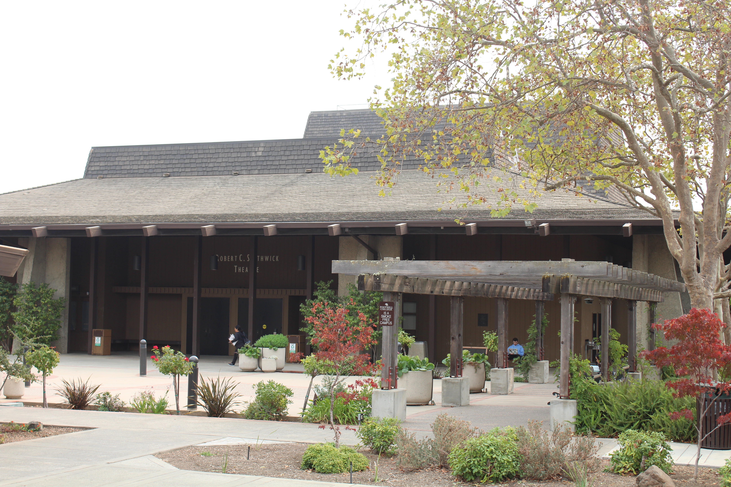
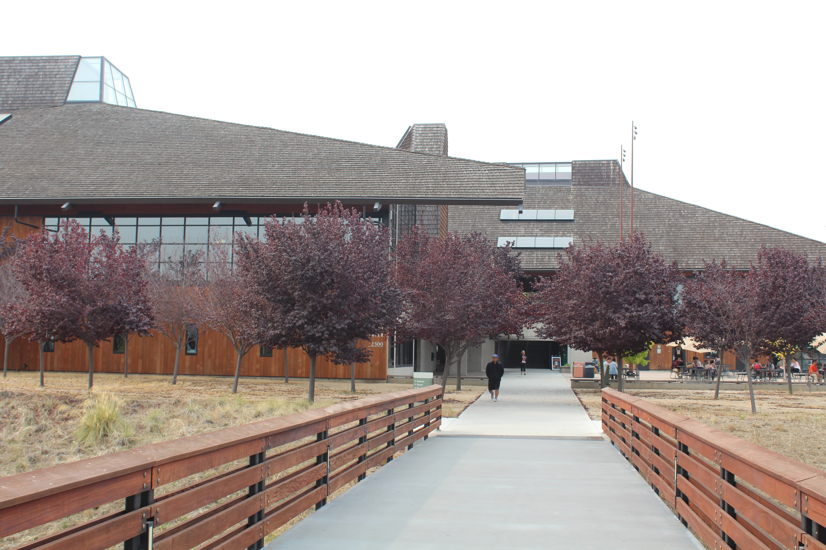
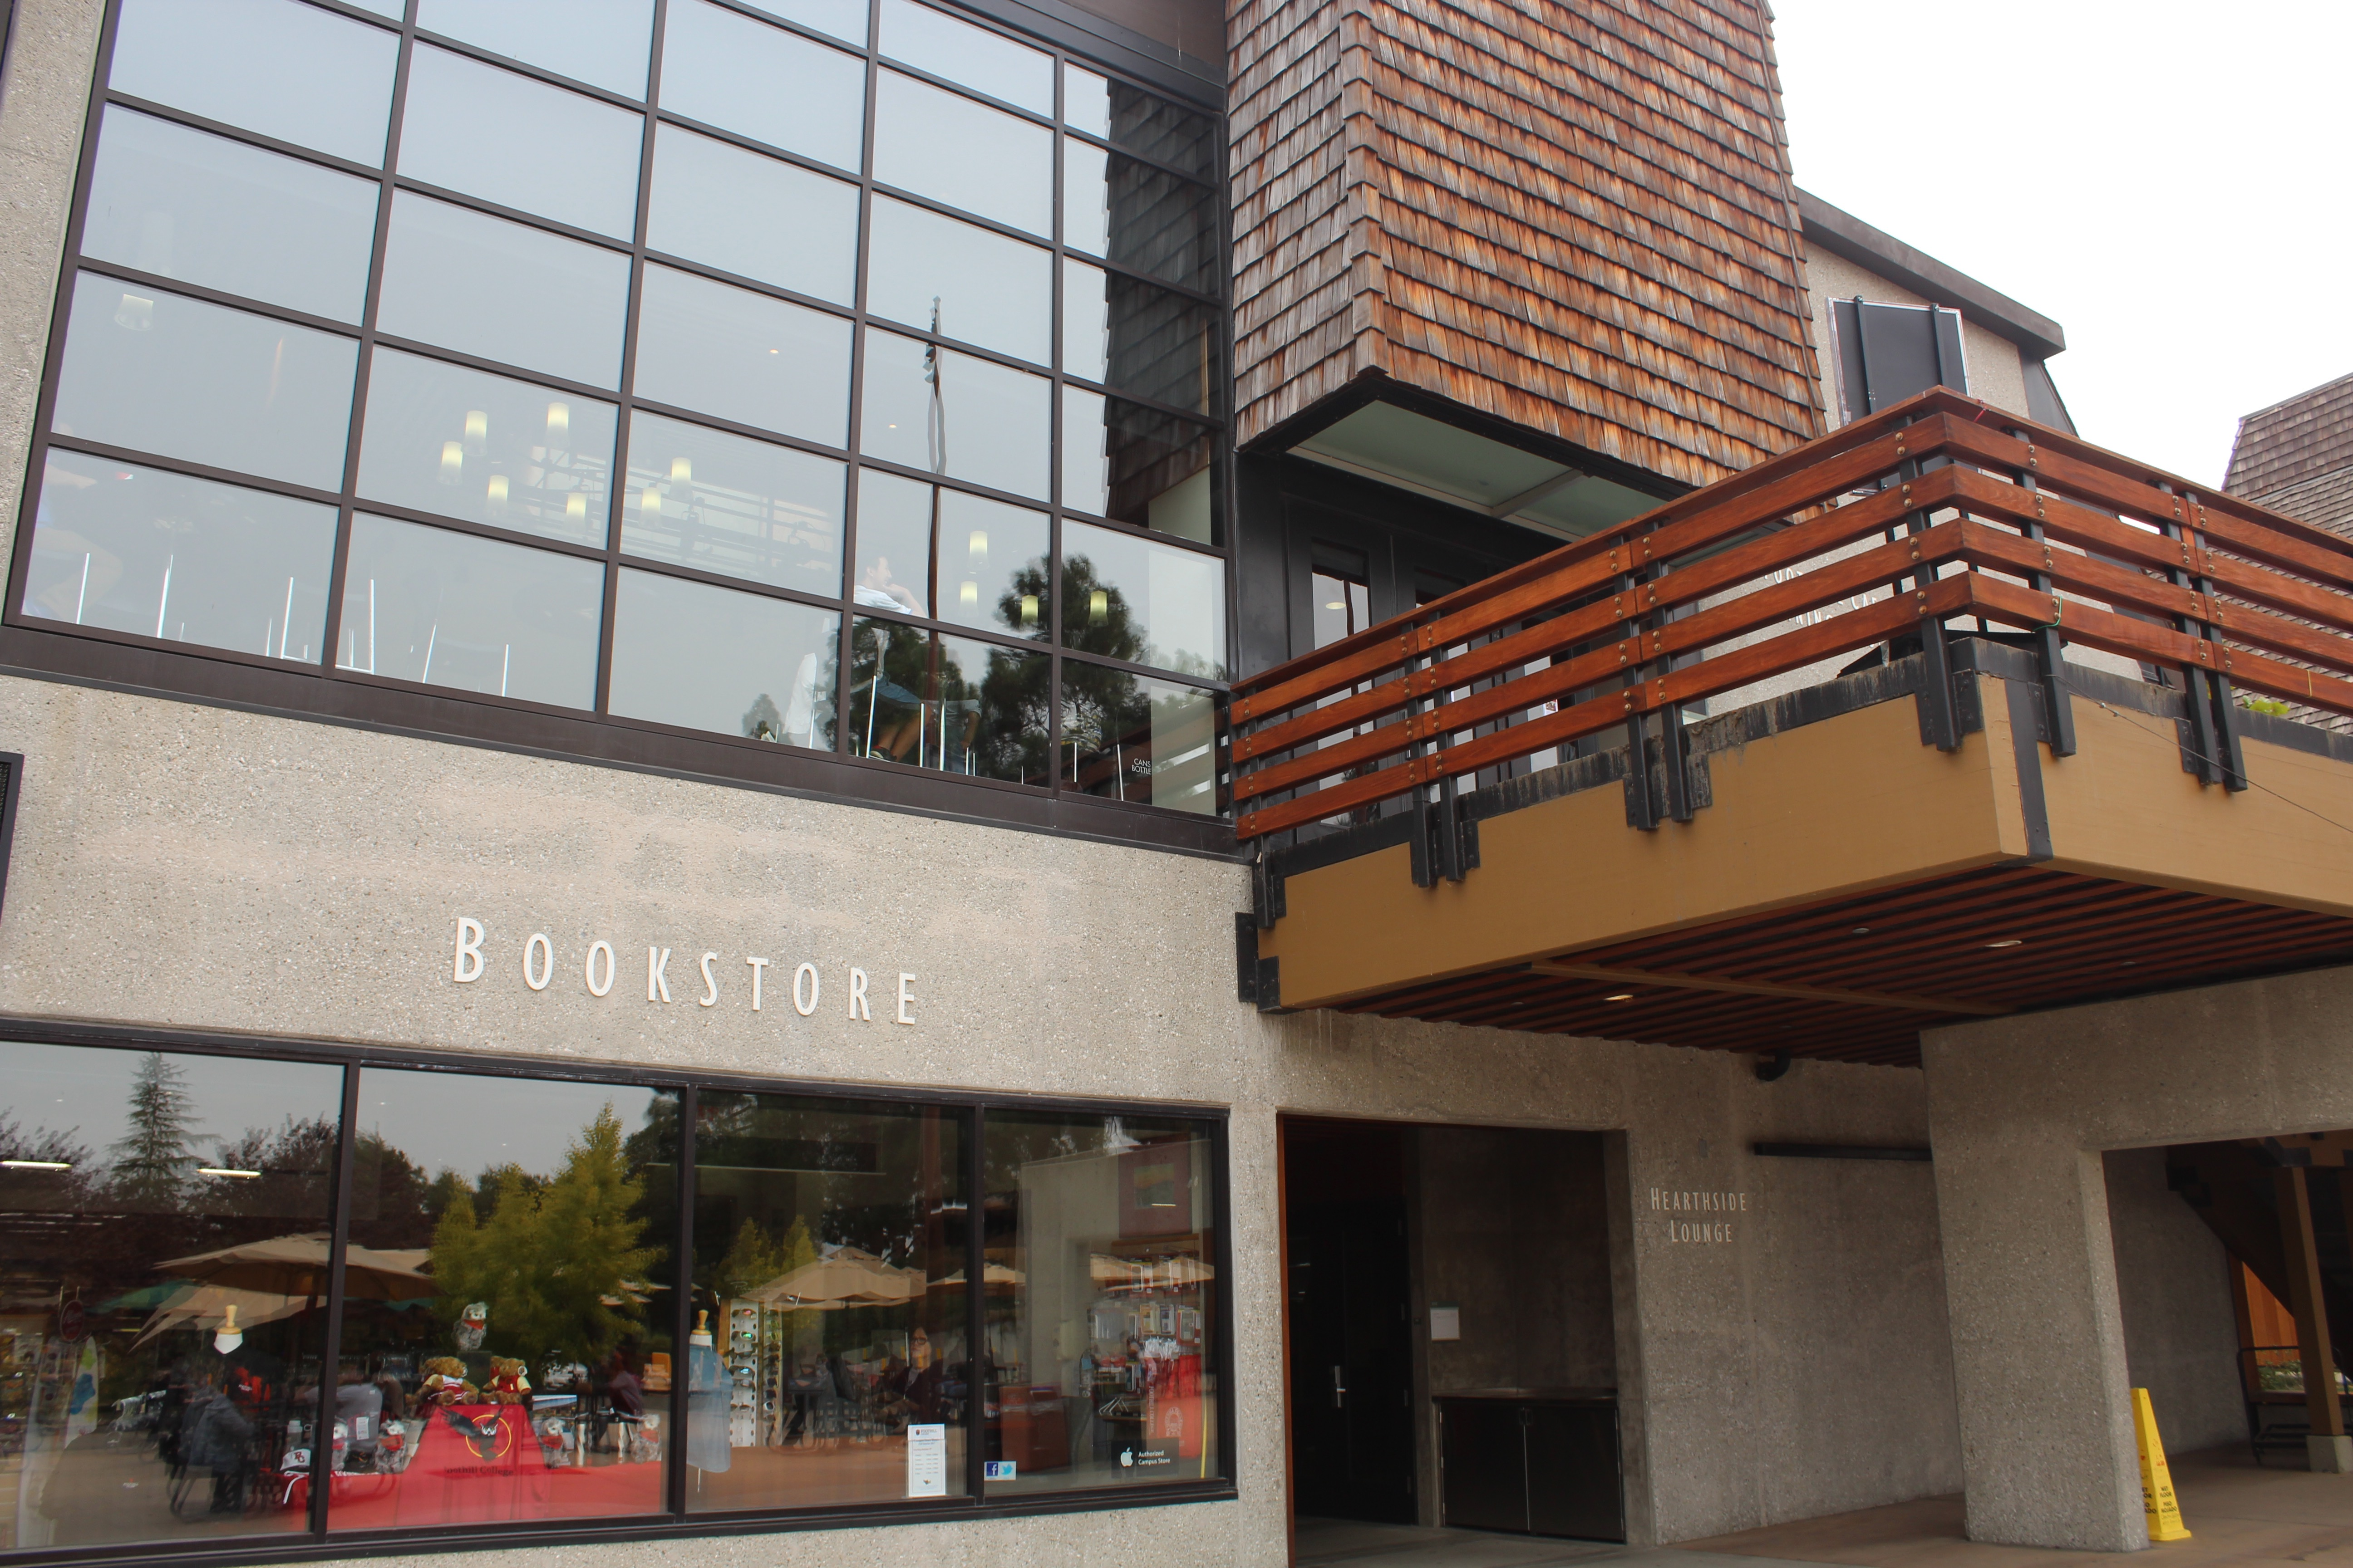
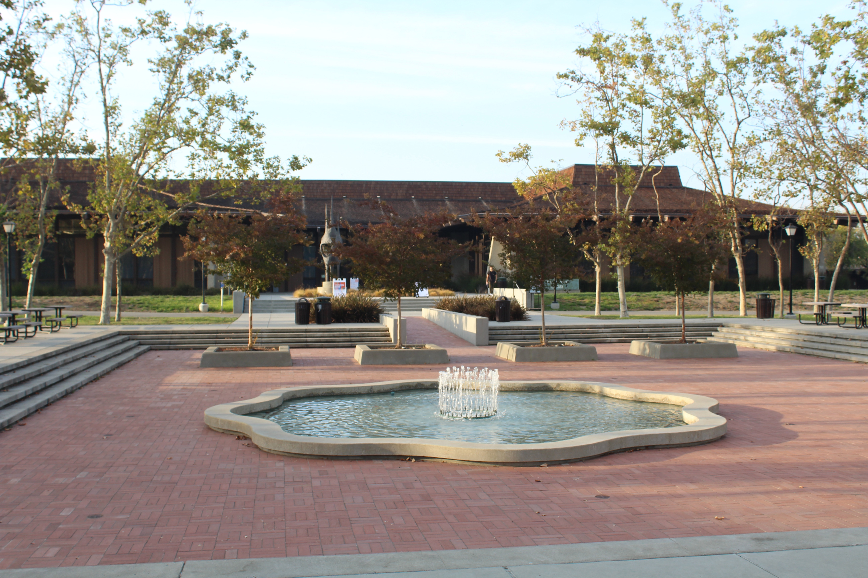
Our Mission
Believing a well-educated population is essential to sustaining and enhancing a democratic society, Foothill College offers programs and services that empower students to achieve their goals as members of the workforce, as future students, and as global citizens. We work to obtain equity in achievement of student outcomes for all California student populations, and are guided by our core values of honesty, integrity, trust, openness, transparency, forgiveness, and sustainability. Foothill College offers associate degrees and certificates in multiple disciplines, and a baccalaureate degree in dental hygiene.
Approved by Planning & Resource Council (PaRC) in April 2017; Approved by Board of Trustees in May 2017

Slide 4
Timelines:
July 1, 2018 - Budget Reductions for Years 1 & 2 (total of $1,750,000) must be identified.
July 1, 2019 - Year 1 & 2 cuts must be fully implemented.
December 31, 2018 – Year 3 cuts of $1,750,000 shall be identified.
July 1, 2019 – Year 3 cuts must be fully implemented.
Develop strategy and timeline for additional cuts due to 2017-18 decline of FTES.

Slide 5
Consultation: Participatory governance and town hall
Round 1: Budget Reduction & Proposed Percentage Cuts in Each Division
September 14, 2017: Governance Summit —> present information about budget reductions percentages
November 8, 2017: Town hall at main campus (Hearthside)
November 30, 2017 (Sunnyvale) / December 5, 2017 (Hearthside): District town halls
November 1 & 15, 2017: PaRC regarding Proposed % Cuts in each Division
Round 2: Guiding Principles & Discussion by Divisions on Possible Budget Cuts
January 22, 2018: Cabinet retreat
January 25, 2018: Admin Council retreat
January 31, 2018: PaRC
Round 3: Finalize list of reductions for Year 1 & 2
March 22: Cabinet retreat
April 19: Town Hall
April 18 & 25: PaRC
April/May: Finalize list to District

Slide 6
Resident Enrollment: (2009/10 – 2017/18 Projected)

Slide 7
P-2 Resident and Non-Resident Enrollment Projections 2017-18
Resident Enrollment | 2016/17 | Projected 2017/18 | Total
De Anza | 15,340.54 | 14,259.77 | -1,080.77
Foothill | 10,626.98 | 10,273.02 | -353.96*
Total | 25, 967.52 | 24,532.79 | -1,434.73
Non-Resident Enrollment | 2016/17 | Projected 2017/18 | Total
De Anza | 2,856.76 | 2,686.34 | -170.42
Foothill | 1,756.99 | 1,691.43 | -65.56
Total | 4,613.75 | 4,377.77 | -235.98
Grand Total | 30,581.27 | 28,910.56 | -1,670.71
P-2 enrollment figures are estimates and are not final.
*Decline in enrollment is because of ISA’s.
Resident Enrollment (Non-ISA) is up approx. 400 FTES or 4% compared to 2016-17.

Slide 8
Budget Reduction Background:
Structural budget deficit of -$10.3M for 2017/18. http://business.fhda.edu/budget/annual-budget-and-quarterly-report.html
District Budget reductions strategy includes:
-$2M for 17/18, -$3M for 18/19, & -$5M for 19/20. Total of -$10 Million.
Distribution of reductions is (35% Foothill, 50% De Anza, & 15% District).
Foothill’s share of the reduction is $3.5M.

Slide 9
Additional Budget Reductions:
January 2018 - P-1 Enrollment estimates for 2017/18 were estimated to be down -859 FTES.
April 2018 – P-2 Enrollment is estimated to be down approx. -1,400 FTES for 2017/18.
Due to projected decline in FTES, District recommends an additional reduction of -$5.3 M for year 3 (total of -$15.3 M) for the 3 years.
New District Budget reductions strategy reflects:
-$2M for 17/18, -$3M for 18/19, & -$10.3M for 19/20. Total of -$15.3 Million.
Distribution of reductions is (35% Foothill, 50% De Anza, & 15% District).
Foothill’s share of the reduction is now $5.355 M (original reduction was $3.5M).

Slide 10
Breakdown of Reduction Target Amounts by Division(s):
Division(s) | 2017-18 & 2018-19 | 2019-20 | (Subtotal) | Percent % | Additional | Total
Finance, Marketing, & President’s | $350,000 | $350,000 | $750,000 | 20% | ???
Instruction & Workforce Development | $700,000 | $700,000 | $1,400,000 | 40% | ???
Student Services | $700,000 | $700,000 | $1,400,000 | 40% | ???
Total | $1,750,000 | $1,750,000 | $3,500,000 | 100% | $1,855,000 | $5,355,000

Slide 11
Fund Balance (Actual and Projected):
Ending fund balance and stability fund peaked in 2015-16 in part due to $15.1 M one-time mandated cost claims reimbursement.
Projections reflects reduction of ending fund balance and stability fund despite $15.3 M in reductions to expenses.

Slide 12
Productivity by College:
Productivity = Weekly Student Contact Hours (WSCH) divided by Full-time Equivalent Faculty (FTEF).
District Adopted Budget for 2017-18 reflected 509 productivity.
Focus on staying within the 1320 budget.

Slide 13
Breakdown of Reduction Target Amounts by Division(s):

Slide 14
Breakdown of Reduction Target Amounts by Division(s):
19%
44.8%
36.2%

Slide 15
Savings by Division:

Slide 16
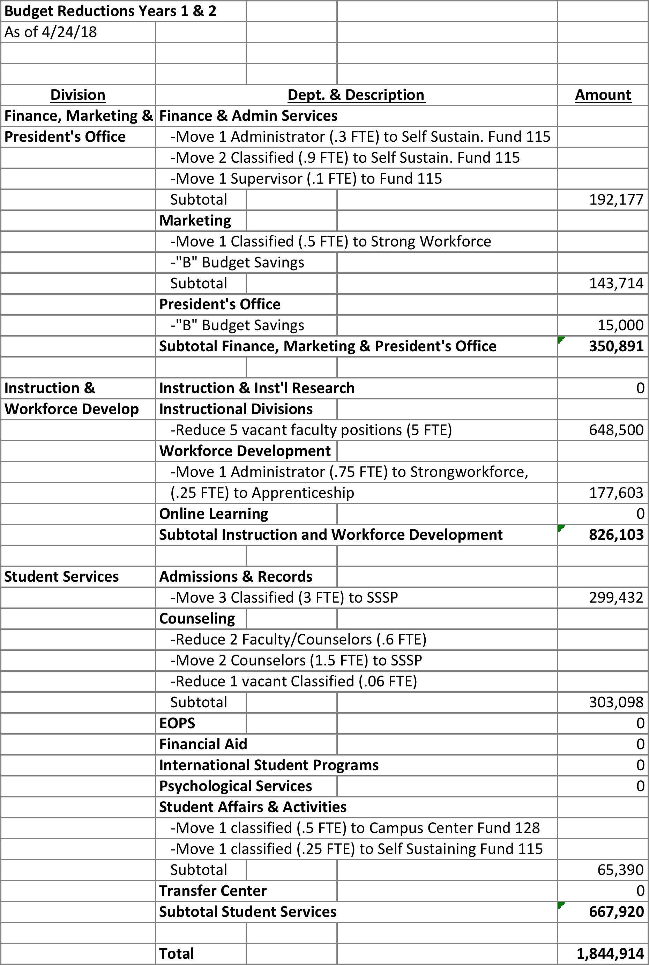
Savings by Division – Augmented Information:

Slide 17
How we are Saving:
Categorical Programs (SSSP, Student Equity, Strong Workforce)
Vacancies (full-time faculty, retirements)
“B” Budget
Self-Sustaining Fund (Rental Facilities/Fine Arts)
Campus Center Use Fees (Fund 128)
Foundation (KCI Program)
Raise Printing Fees (Support Printing Services Position)
Reduce release time, stipends, comp-time & over-time

Slide 18
Eight Proposed Guiding Principles for Reductions:
1) Preserve Quality Education
Student centered focus
Support equity
Remain innovative
Maintain our quality and excellence
2) Strategic Enrollment Growth
Evaluate both qualitatively and quantitatively
Maintain resources for growth
Serve students in an innovative way
3) Cabinet Review/Approval
Hiring to fill all vacancies
Faculty positions that are 11 & 12 mo.
Evaluate Reassigned time
Sabbaticals (planning/scheduling)
Notes:
Managed Hiring.
-Evaluate on a case by case basis the vacant positions.
-Full-time faculty want to be strategic. Look at FON and hire some full-time faculty in order to maximize enrollment.
Tightening of Budget

Slide 19
Guiding Principles Continued…
4) No layoffs of full-time positions for 2017-18 & 2018/19.
Use one-time funds if needed.
Person may do something different.
May use different funding sources
Open, consistent and sustained communication
Respect for privacy and timing of notification
5) Spending relates to strategic objectives.
Aligned with enrollment and productivity goals.
Exceptions (i.e. students needing one class to earn ADT).
Provide advanced annual offerings for students to plan.
Notes:
4) The group agrees with the proposal as written…however, delaying difficult decisions does not reduce pain in the long run if enrollment/budget challenges continue
-Transparency
-Open, consistent and sustained communication
Participation and opportunity for feedback
Respect for personal privacy
Reasonable timing
Hear probable news earlier

Slide 20
Guiding Principles Continued…
6) Transparency
Open Communication
Reasonable timing when sharing information.
7) Shared Pain
Faculty, classified and management units will be impacted.
Kindness & empathy
8) Program Review/Elimination
Follow program review process/statutes/regulations
Analysis of impact of program/college/community
Transparency with clear rubric
One-year timeframe to grow enrollment

Slide 21
What have we done and what do we need to do?
Identified savings for years 1 & 2.
No planned layoffs of filled positions through 2018-19.
Ongoing cuts include:
Moves to other funding sources
Utilizing vacant positions
Reduce “B” budget.
Identify additional Year 3 savings.
Continue to explore ways to become more efficient.

Slide 22
Fiscal Outlook:
Fiscal Self Assessment (Board of Trustees March 5, 2018): https://www.boarddocs.com/ca/fhda/Board.nsf/Public
2nd Quarter Budget Report: http://business.fhda.edu/budget/annual-budget-and-quarterly-report.html
Apportionment (P-2 Enrollment Report), April 20
New Funding Formula for 2018-19
Productivity for 2018-19:
Colleges must stay within the 1320 budget.
If actual costs for 1320 exceeds budget, college pays the difference.

Slide 23
Fiscal Self Assessment cont’d:
2016-17 included a $6.3 M projected deficit
$9.1 M reduction to the ending Fund Balance
Enrollment dropped 1176 FTES ≈ $6 million in lost revenue
Ending Fund Balance was $48.8 million or 27.4% of GF expenses
2017-18 projected deficit of -$10.3 million
2017-18 ending fund balance is projected at $39 million
FTES is projected down approximately 900 FTES (based on P-1)
Cashflow is good, internal controls-good, management info. system is good.
Plan for $10 million in cuts over 3 years (and additional reductions) to bring expenses in line with revenues.

Slide 24
Information & Feedback:
Budget Updates can be found at: https://foothill.edu/president/updates.html
Feedback regarding budget conversations can be made at: https://foothill.edu/president/feedback.html

Slide 25
Questions?

