Slide 1
Budget Overview Town Hall Meeting
Bret Watson
Associate VP of Finance
November 8, 2017

Slide 2
Overview:
History of FTES and Productivity
Impact on the 2017-18 Budget
District/Foothill College Reduction Targets
Revenue & Expense Planning
Timelines

Slide 3
Historical and Current Resident/Non-Resident Enrollment

Slide 4
Historical Credit & Non-credit FTES
Under SB361, FTES restoration is available for a 3-year window, after the year of decline, to recapture the total FTES lost for the years within that 3-year period.
1,474 FTES available to restore or $7.6M
1,386 FTES available to restore or $7.1M
Any of the 1,176 FTES or $6.0M not restored by this time results in a new base.

Slide 5
FTES generated from courses offered.
2017-18 Projected Productivity – 509.

Slide 6
Allocation of 2016-17 Ending Fund Balance
2016-17 Ending Fund Balance $ 48.8M
Colleges & Central Services B budget carryover $ 12.3M
District-wide carryover (negotiated contract items,
EIS/ETS backfill and encumbrance carryforwards) $ 2.8M
Maintain district’s budgeted 5% reserve $ 10.0M
Stability Fund $ 23.7M

Slide 7
2017-18 Projected Ending Fund Balance:
Beginning Fund Balance July 1, 2017 $ 48.8M
Plus: Revenue 188.9M
Less: Expenses 192.8M
Less: Transfers Out 6.5M
Projected Structural Deficit $(10.4M)
Plus: One-Time District-wide savings 1.0M
Net Change - Projected Fund Balance $ (9.4M)
Projected Ending Fund Balance (June 30, 2018) $ 39.4M
Fund Balance Allocation:
College & Central Services Carryforwards $ 12.3M District-wide Carryforward 2.8M Required 5% Budgeted Reserve 9.9M
Projected Stability Fund at June 30, 2018 $ 14.4M

Slide 8
Background:
Structural budget deficit of -$10.4M for 2017/18.
District Budget reductions strategy includes:
-$2M for 17/18
-$3M for 18/19
-$5M for 19/20.
Distribution of reductions is (35% Foothill, 50% De Anza, & 15% District).

Slide 9
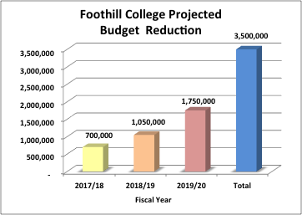
Foothill’s Portion of Reductions:
Foothill’s portion is $700,000 for 2017/18.
Another $1,050,000 for 2018/19 for Yr. 2.
*Additional cuts for Yr. 3 of $1,750,000 for 2019/20.
Total is $3.5 M.
*Based on FTES and financial outlook.

Slide 10
Portion of Reductions (continued):
For the reduction of $700,000 for (2017-18):
No planned position reductions.
Use carryover/float.
Next year must be a permanent “on-going” reduction.
For (2018/19) Foothill’s total ongoing reduction is $1,750,000.

Slide 11
2017-18 Non-teaching “A” & “B” Budget Amounts

Slide 12
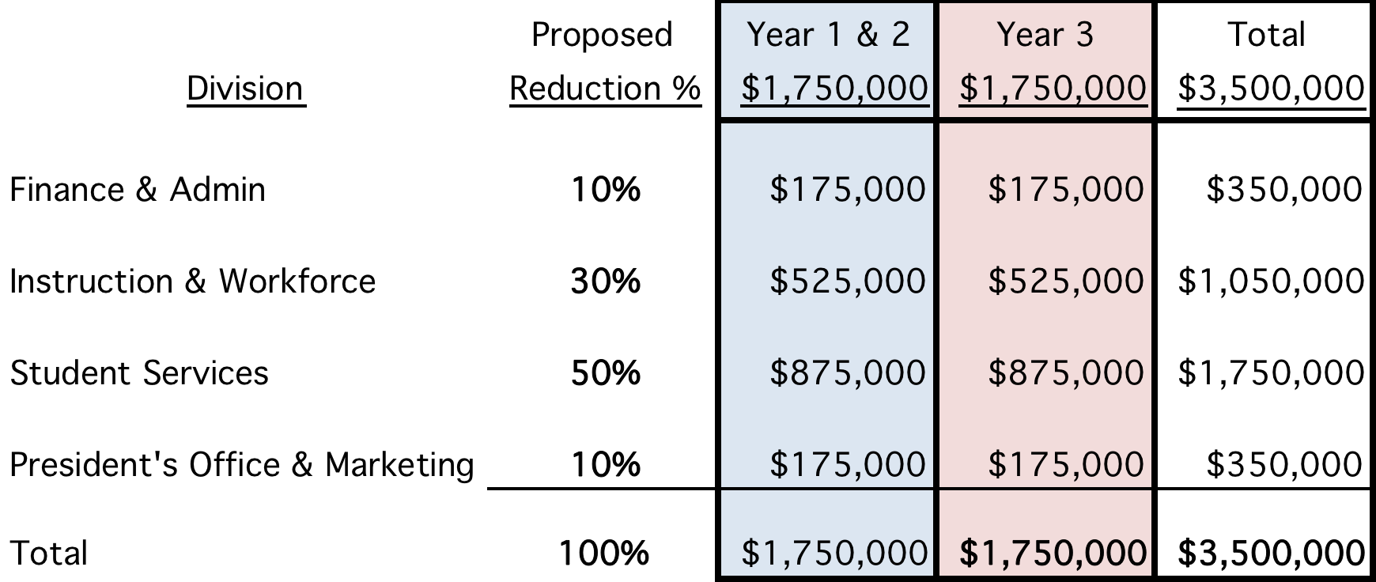
Foothill College-General Fund (proposed targets) by division:

Slide 13
Things that we are doing to help our enrollment.
Summer enrollment increased (≈15%, 200 FTES)
Second spring was also successful
Dual enrollment increased by (30%)
Supplemental instruction (tutoring)
20+ Associate Degrees for Transfer

Slide 14
New programs and events planned for outreach to specific populations:
Homeschooled students
ESL (credit & non-credit)
Dual enrollment students (Early College Promise & private schools)
Apprenticeship students
Older adults (non-credit)
Community members for Physical Education & Fine Arts
Adult Education

Slide 15
Guiding Principles and Strategies for Reductions:
Selective Strategic Hiring
Evaluate vacant positions
Full-time faculty, FON (fill some vacancies)
Tighten Budget
Analyze Schedule (programs and sections)
Develop performance metric
Review service contracts
Notes:
Managed Hiring.
-Evaluate on a case by case basis the vacant positions.
-Full-time faculty want to be strategic. Look at FON and hire some full-time faculty in order to maximize enrollment.
Tightening of Budget

Slide 16
Principles continued….
Move positions to other funding sources:
Categorical programs (caution: supplanting)
Grants (operational costs)
Self Sustaining Fund 115
Foundation
Prioritize Services
Notes:
For Fund 115 look at Apprenticeship (move remaining portion of coordinator from Fund 114).
Executive Director of Facilities (move part of position ie 10% to facilities rental).
Food Services and KJ’s revenue to offset costs of a position.
Move EcoPass/Clipper Card program to Fund 115
Move Printing Services to Fund 115 (move 25%-50% of coordinator’s position)
Categorical Programs-Guided Pathways, SSSP, Strong Workforce, Student Equity-where possible hire positions to support student services, leave vacancies unfilled and eventually give up those positions to fulfill cuts.
Foundation (support additional expenses for Gay Krause/support staff) utilizing Foundation Funds

Slide 17
Other Important Principles:
Sustainability & Resource Stewardship:
Educational expenses, instructional materials, financial aid, health services, etc. to support students success.
Reduce energy consumption (Winter Break).
Stay true to our Mission’s core values: ”honesty, integrity, trust, openness, transparency, forgiveness, and sustainability.”
Notes:
Vacant positons include:
VP Finance
AVP Finance
President’s Assistant
Librarian, Equity
Library Technician
Instructional Services Coord
Dean, Student Affairs & Act
Positions for possible movement:
AVP Workforce Development to Strong Workforce
Program Coord II (Workforce) to Strong Workforce
Theatre and Fine Arts Facilities Rental Coordinator to 115 (about 40% of an FTE)
Printing Services Coordinator 50% to Fund 115 (need to discuss with the district)
Clipper Card/EcoPass move 25% of the Office Coordinator to Fund 115 (need to discuss with district)
Categorical look at operation and

Slide 18
Things to consider:
Preserve revenue generating programs:
Instructional programs/sections analysis. (WSCH/Productivity).
ISP (International Student Program).
DRC-DSP&S (non-credit).
ISA’s-Performing Arts Alliance, YearUp, JTPA, etc. (compliance).

Slide 19
More things to consider:
Maintain match requirements for categoricals.
SSSP (1:1), BFAP, EOPS, DSP&S, etc..
Ongoing ‘B’ budget.
Serve student needs.
Maintain healthy level of operational resources.

Slide 20
Strategies for Budget Reductions:
Implement cost cutting strategies:
Evaluate vacant classified, faculty, and administration positions (Selective Strategic Hiring).
Move positions to other funds (Self-Sustaining, Categorical Funds, & Grants).
Reduce Services.
Review Service Contracts.
Discretionary “B” Budget.
Reduce Positions.

Slide 21
Timeline:
July 1, 2018 - Budget Reductions of $700,000, plus the $1,050,000 must be identified.
July 1, 2019 - Year 1 & 2 cuts must be fully implemented.
July 1, 2019 - *Additional $1,750,000 shall be identified.
Consultation: Participatory governance and town hall
*Based on FTES figures and financial outlook.

Slide 22
Feedback?

Slide 23


