Slide 1
Budget Reduction Strategies Foothill College
Bret Watson
Associate VP of Finance
Governance Summit
September 14, 2017

Slide 2
Background:
Structural budget deficit of $10.4M for 2017/18.
Budget reductions strategy includes -$2M for 17/18, -$3M for 18/19 and -$5M for 19/20.
Distribution of reductions is (35% Foothill, 50% De Anza, & 15% District).

Slide 3
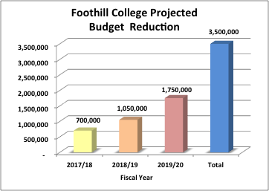
Foothill’s Portion of Reductions:
Foothill’s portion is $700,000 for 2017/18.
Another $1,050,000 for 2018/19.
If enrollment is not restored, additional cuts of $1,750,000 for 2019/20.
Total is $3.5 M.

Slide 4
Portion of Reductions (continued):
For the reduction of $700,000 for (2017-18):
No planned position reductions.
Use carryover/float.
Cost-savings (e.g. software contracts)
Next year must be a permanent “on-going” reduction.
For (2018/19) Foothill’s total ongoing reduction is $1,750,000.

Slide 5
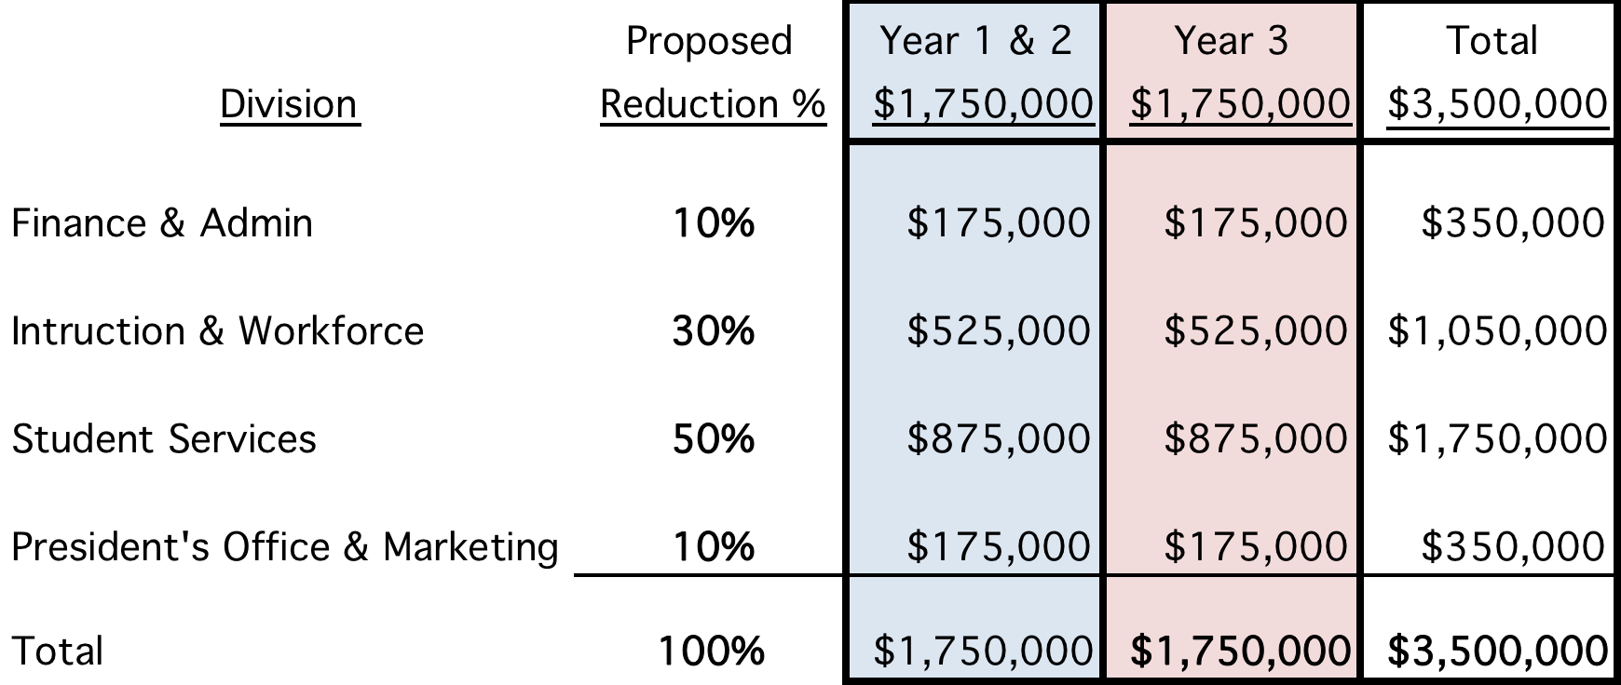
Foothill College (proposed) breakdown by division:

Slide 6
Guiding Principles and Strategies for Reductions:
Managed Hiring
Evaluate vacant positions
Full-time faculty, FON (fill some vacancies).
Tighten Budget
Analyze Schedule (programs and sections).
Develop performance metric.
Review service contracts.
Notes:
Managed Hiring.
-Evaluate on a case by case basis the vacant positions.
-Full-time faculty want to be strategic. Look at FON and hire some full-time faculty in order to maximize enrollment.
Tightening of Budget

Slide 7
Principles continued….
Move positions to other funding sources:
Categorical programs (caution: supplanting)
Grants (operational costs)
Self Sustaining Fund 115
Foundation
Prioritize Services
Notes:
For Fund 115 look at Apprenticeship (move remaining portion of coordinator from Fund 114).
Executive Director of Facilities (move part of position ie 10% to facilities rental).
Food Services and KJ’s revenue to offset costs of a position.
Move EcoPass/Clipper Card program to Fund 115
Move Printing Services to Fund 115 (move 25%-50% of coordinator’s position)
Categorical Programs-Guided Pathways, SSSP, Strong Workforce, Student Equity-where possible hire positions to support student services, leave vacancies unfilled and eventually give up those positions to fulfill cuts.
Foundation (support additional expenses for Gay Krause/support staff) utilizing Foundation Funds

Slide 8
Other Important Principles:
Sustainability & Resource Stewardship:
Education, materials, financial aid, health services, etc. to students.
Reduce energy consumption (Winter Break).
Stay true to our Mission’s core values: ”honesty, integrity, trust, openness, transparency, forgiveness, and sustainability.”
Notes:
Vacant positons include:
VP Finance
AVP Finance
President’s Assistant
Librarian, Equity
Library Technician
Instructional Services Coord
Dean, Student Affairs & Act
Positions for possible movement:
AVP Workforce Development to Strong Workforce
Program Coord II (Workforce) to Strong Workforce
Theatre and Fine Arts Facilities Rental Coordinator to 115 (about 40% of an FTE)
Printing Services Coordinator 50% to Fund 115 (need to discuss with the district)
Clipper Card/EcoPass move 25% of the Office Coordinator to Fund 115 (need to discuss with district)
Categorical look at operation and

Slide 9
Things to consider:
Preserve revenue generating programs:
Instructional programs/sections analysis. (WSCH/Productivity).
ISP (International Student Program).
DRC-DSP&S (non-credit).
ISA’s-Performing Arts Alliance, YearUp, JTPA, etc. (compliance).

Slide 10
More things to consider:
Maintain match requirements for categoricals.
SSSP (1:1), BFAP, EOPS, DSP&S, etc..
Ongoing ‘B’ budget.
Serve student needs.
Maintain healthy level of operational resources.

Slide 11
Timeline:
Budget Reductions of $700,000 plus the $1,050,000 implemented by July 1, 2018.
Additional $1,750,000 (if needed) shall be implemented July 1, 2019.
Consultation: Participatory governance and town hall

Slide 12
Questions?

Slide 13


